Slide 1
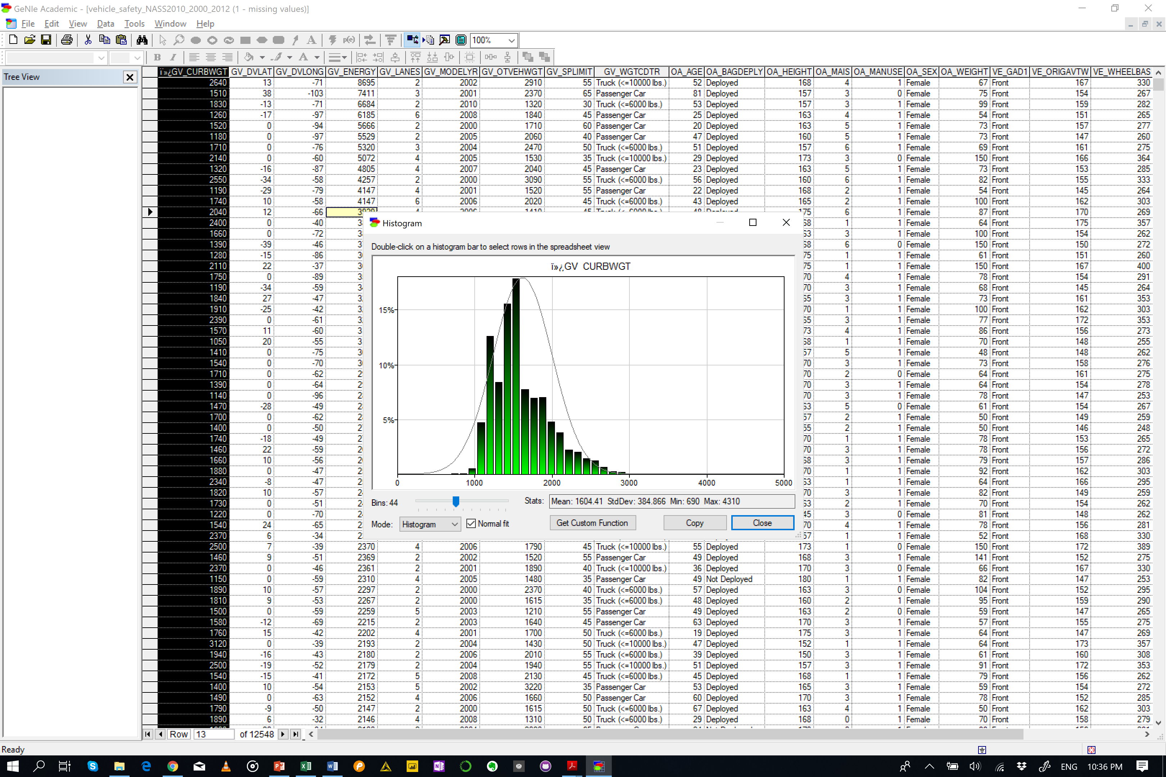
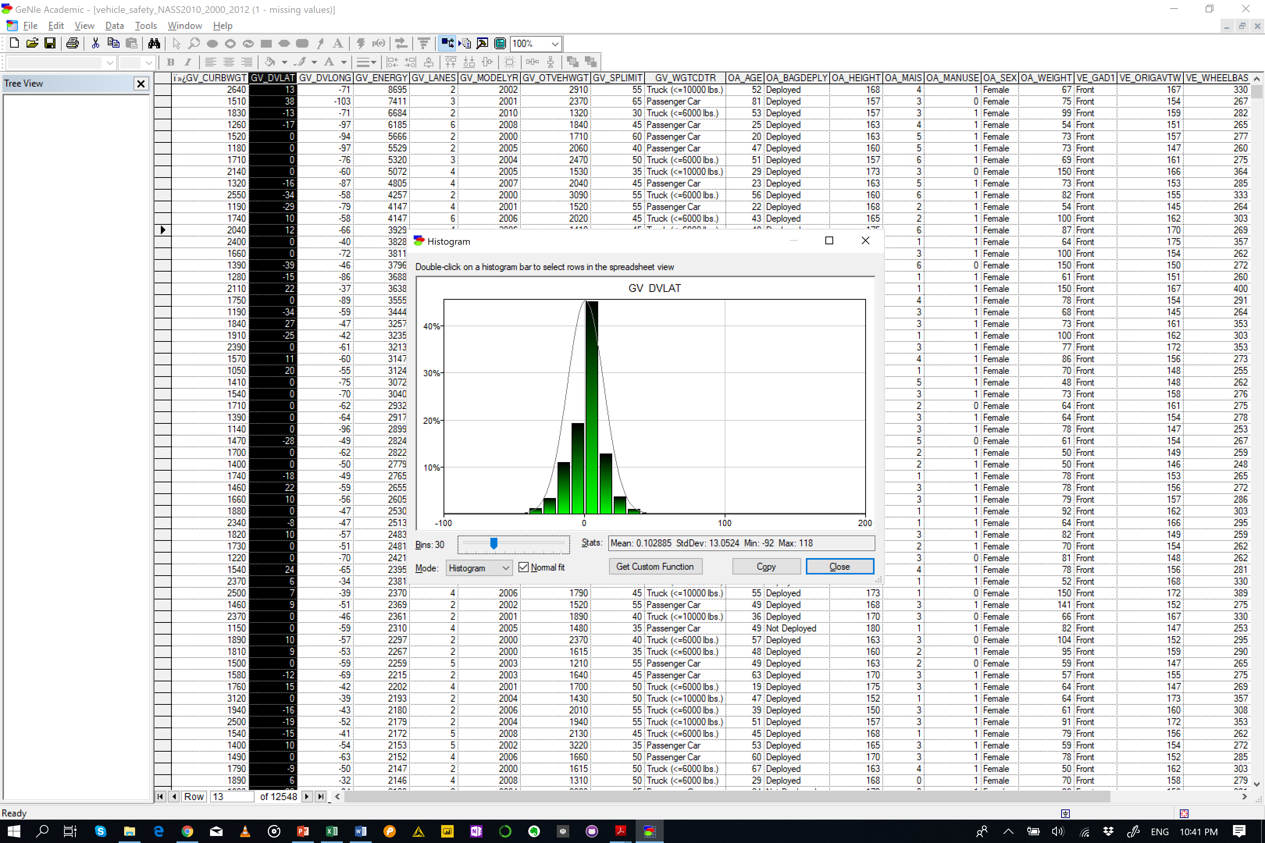
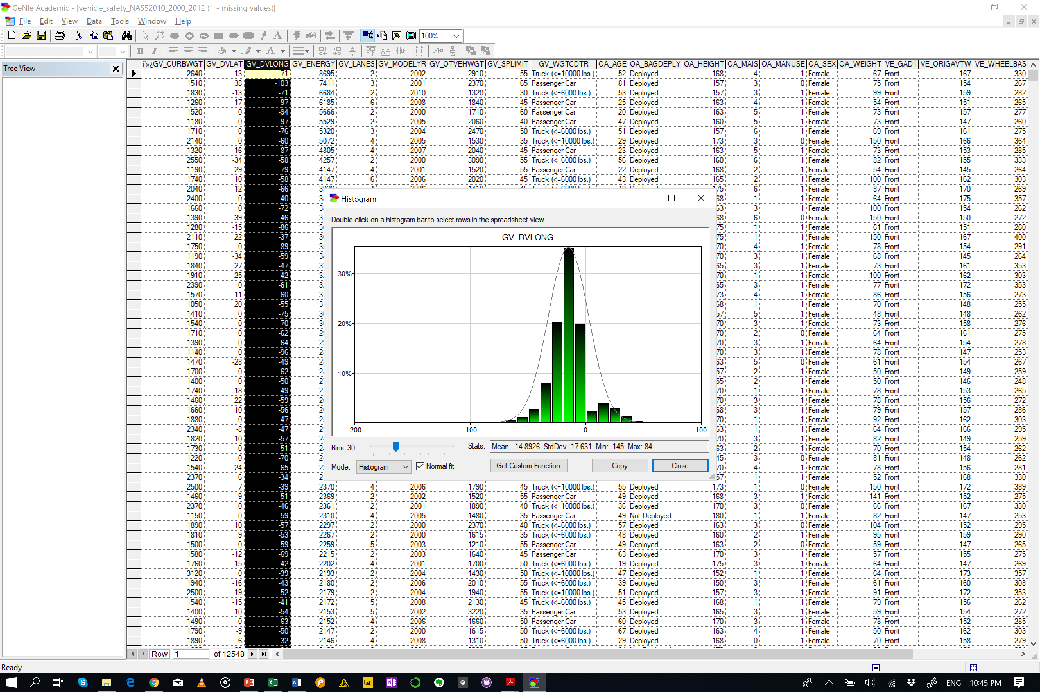
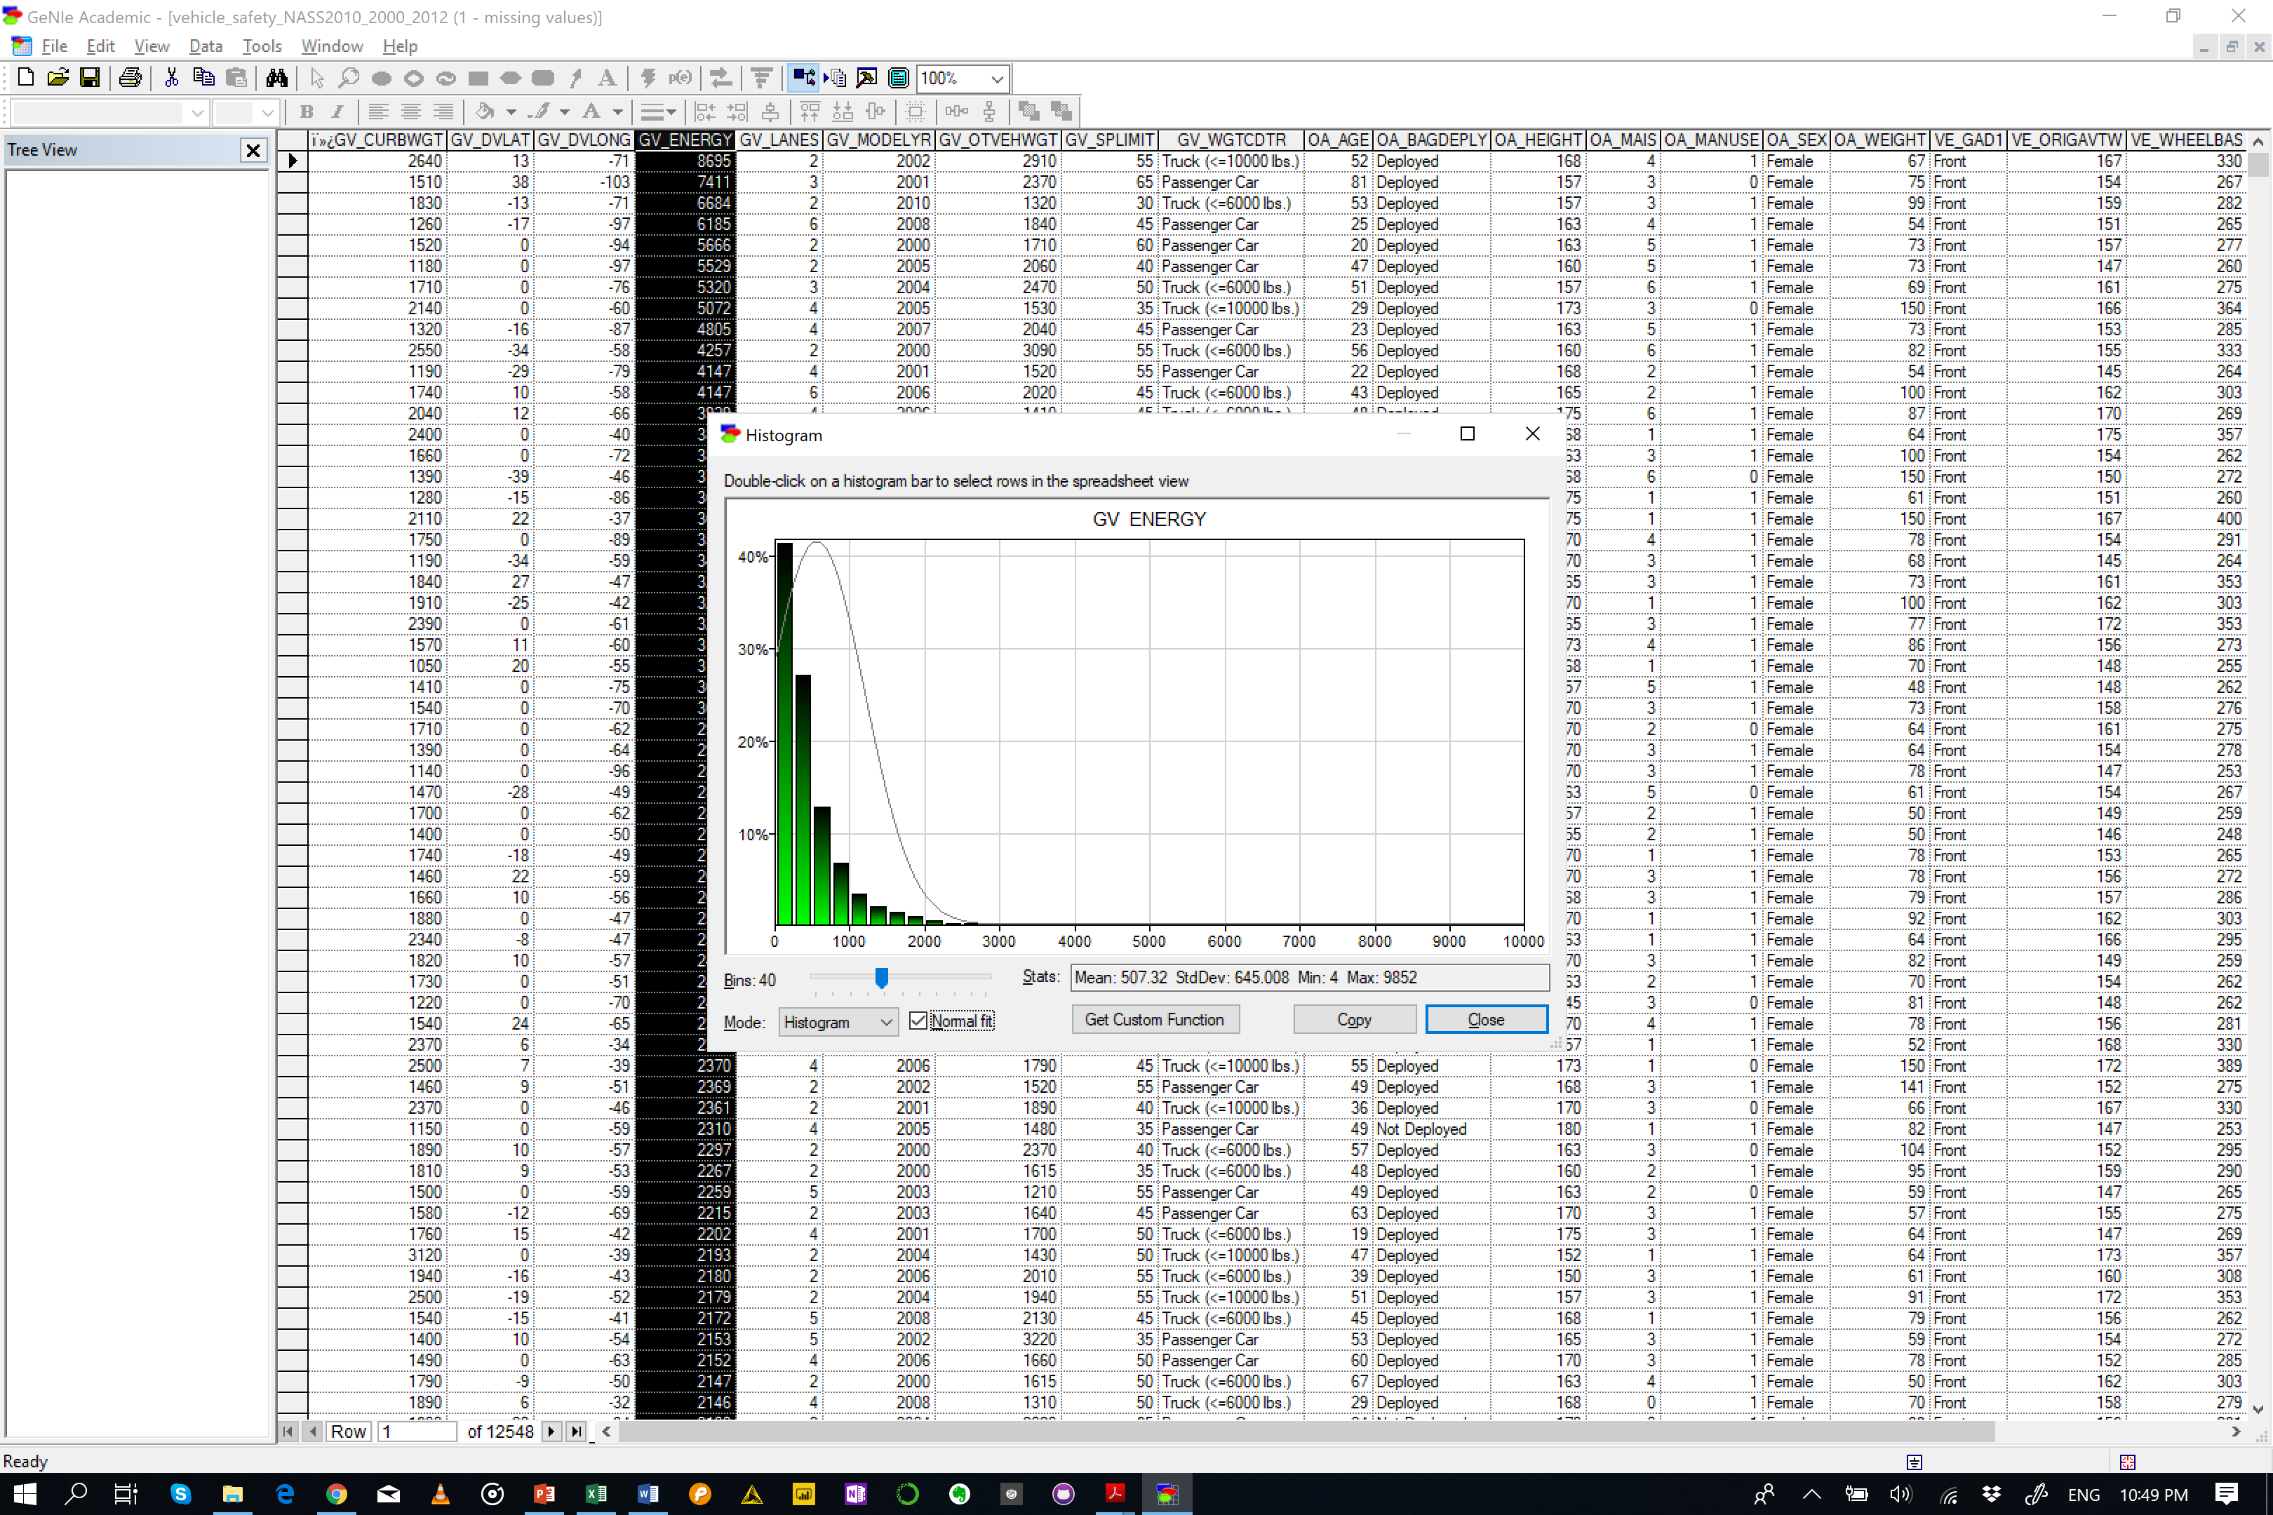
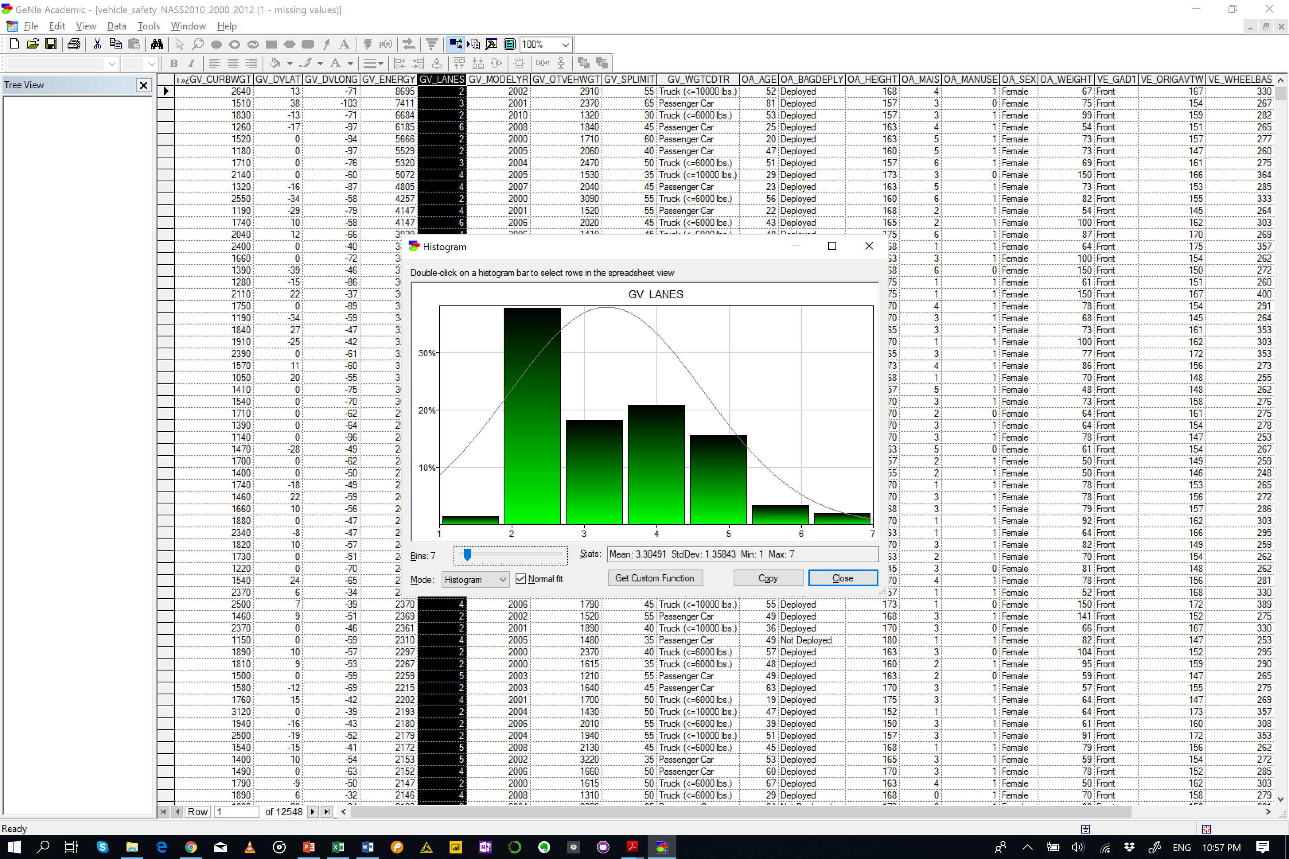
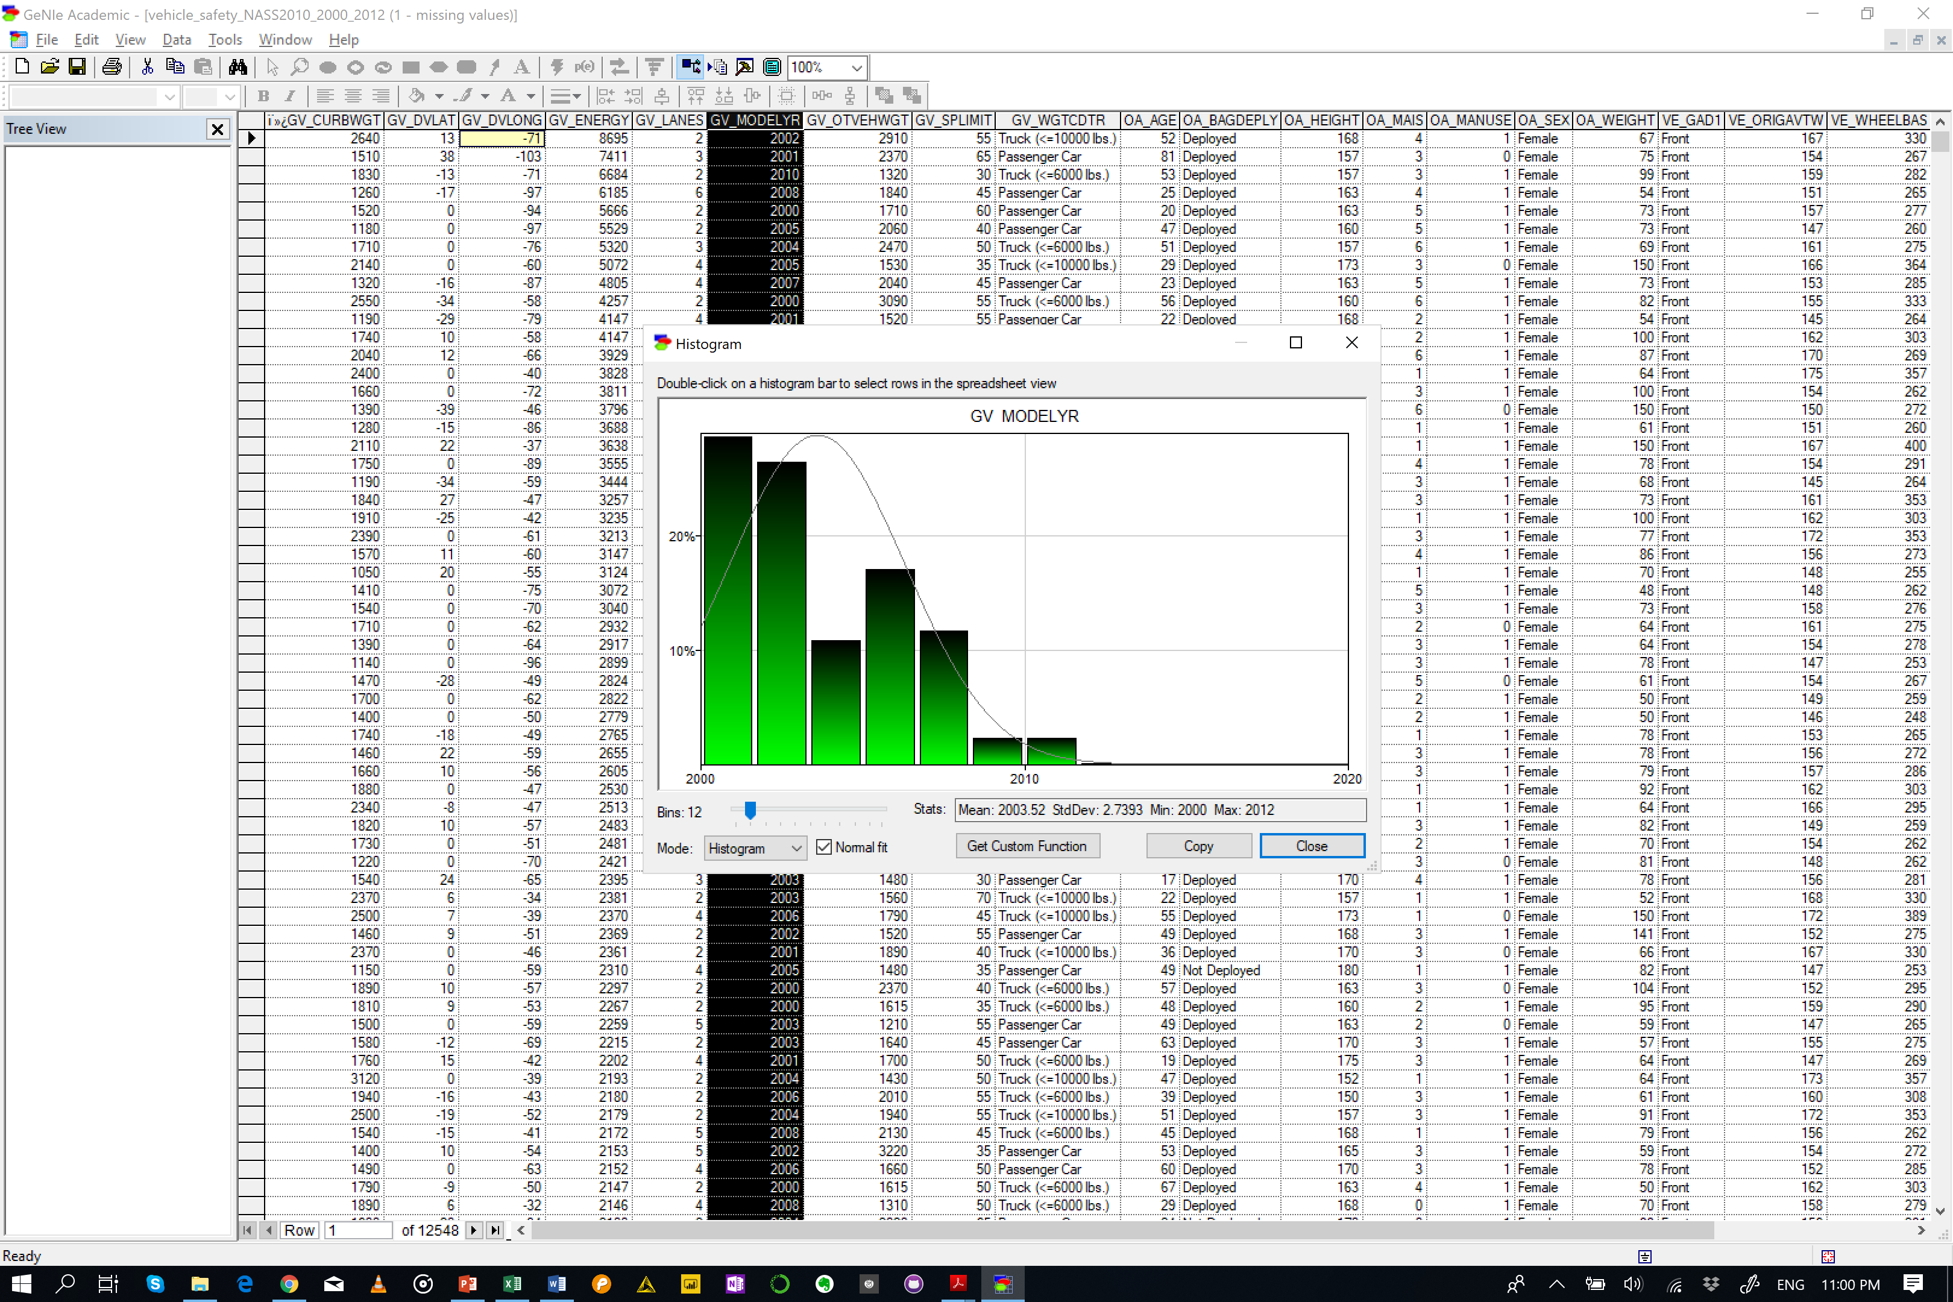
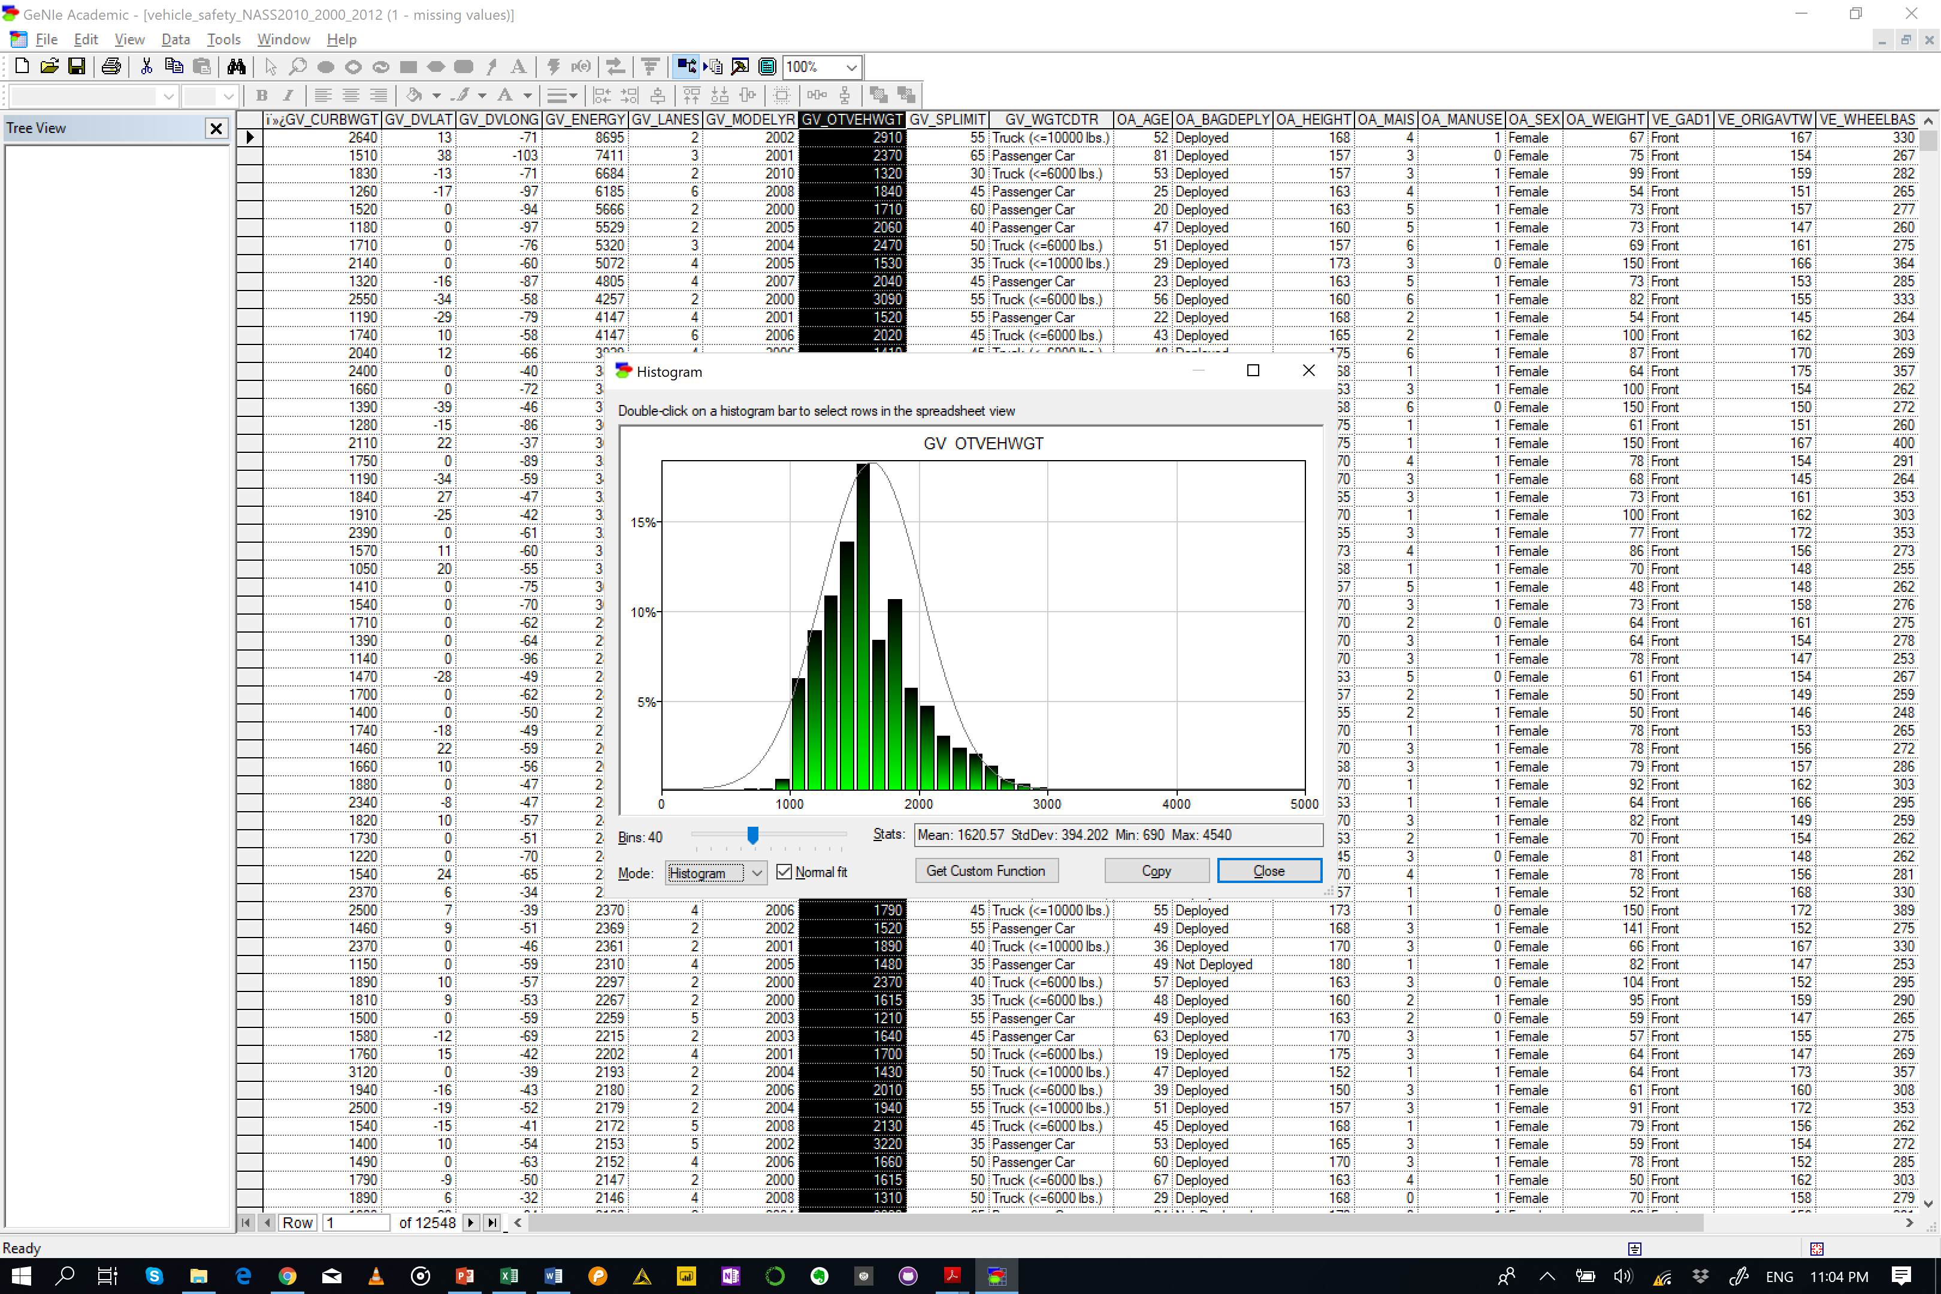
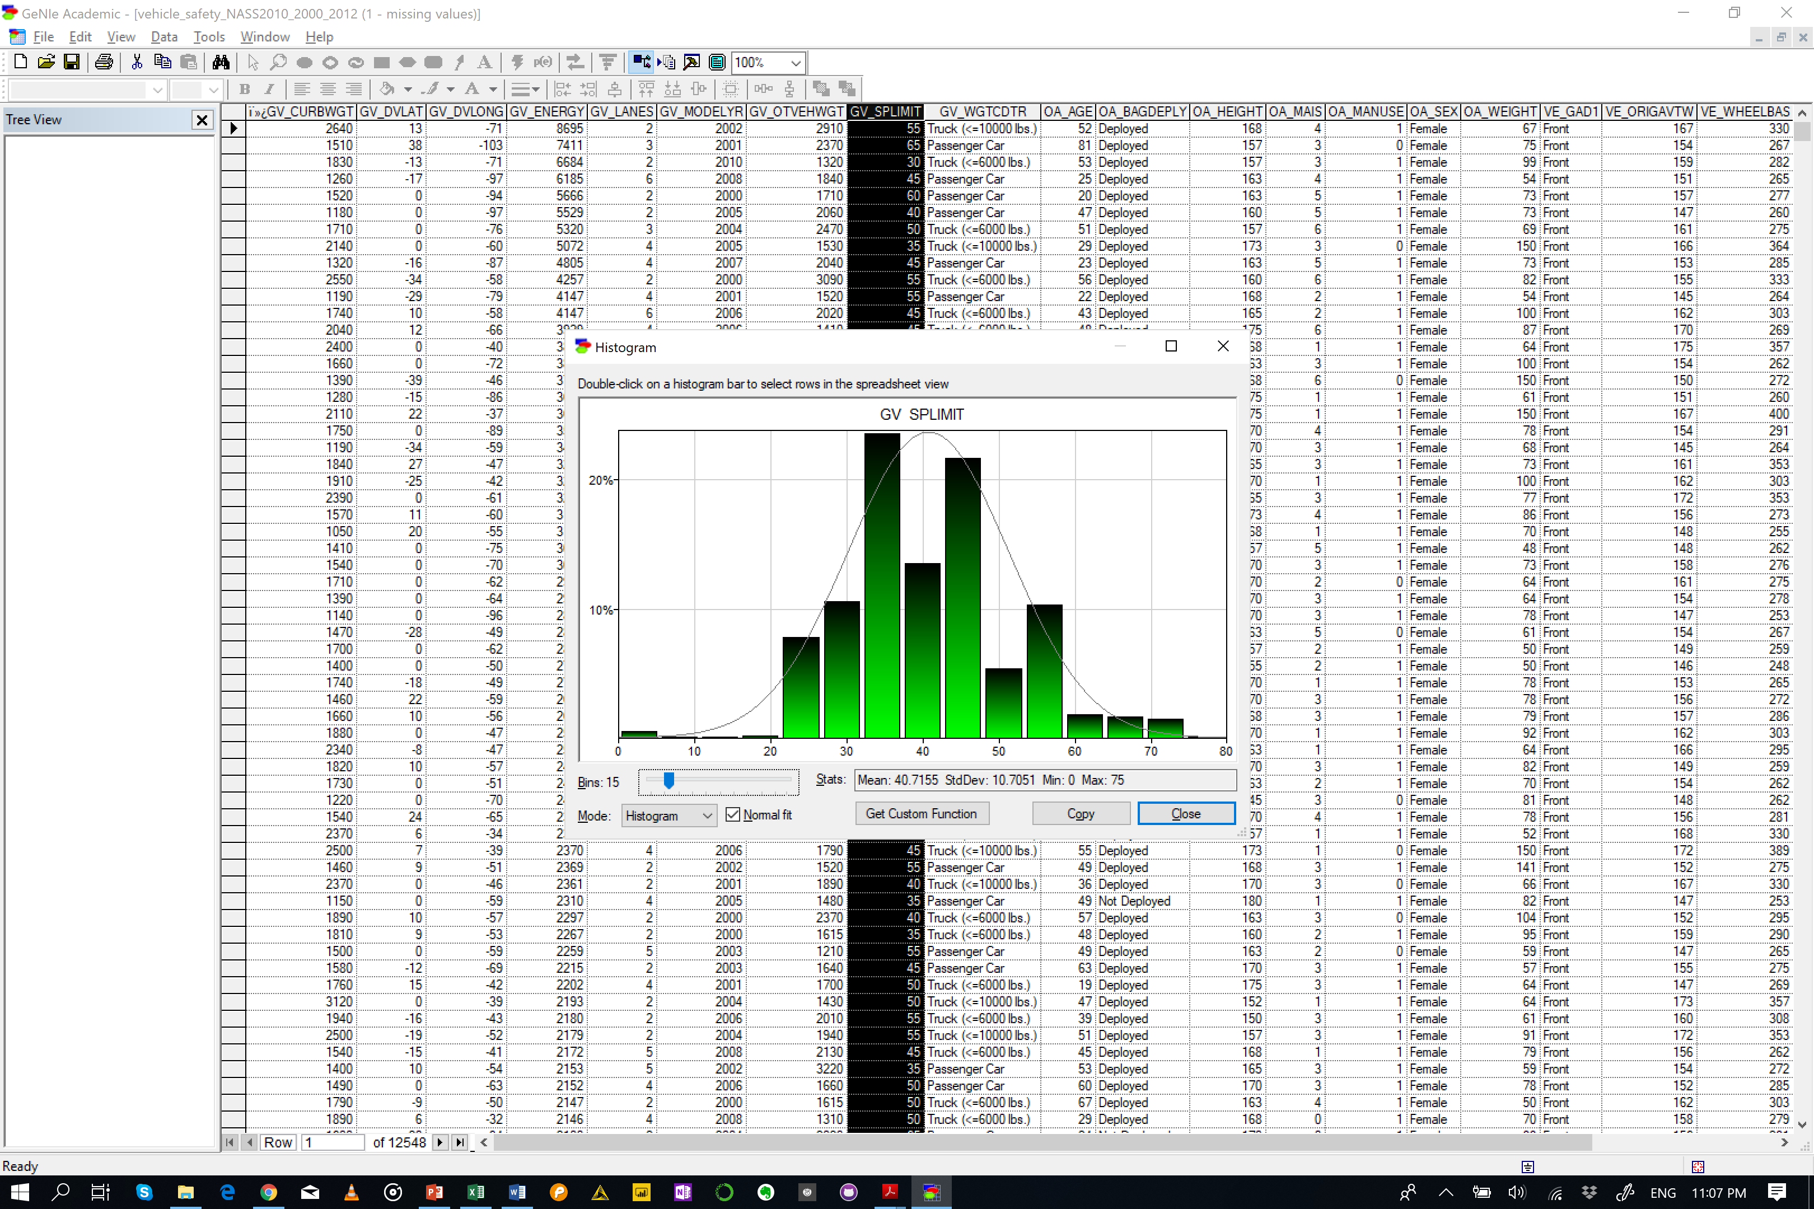
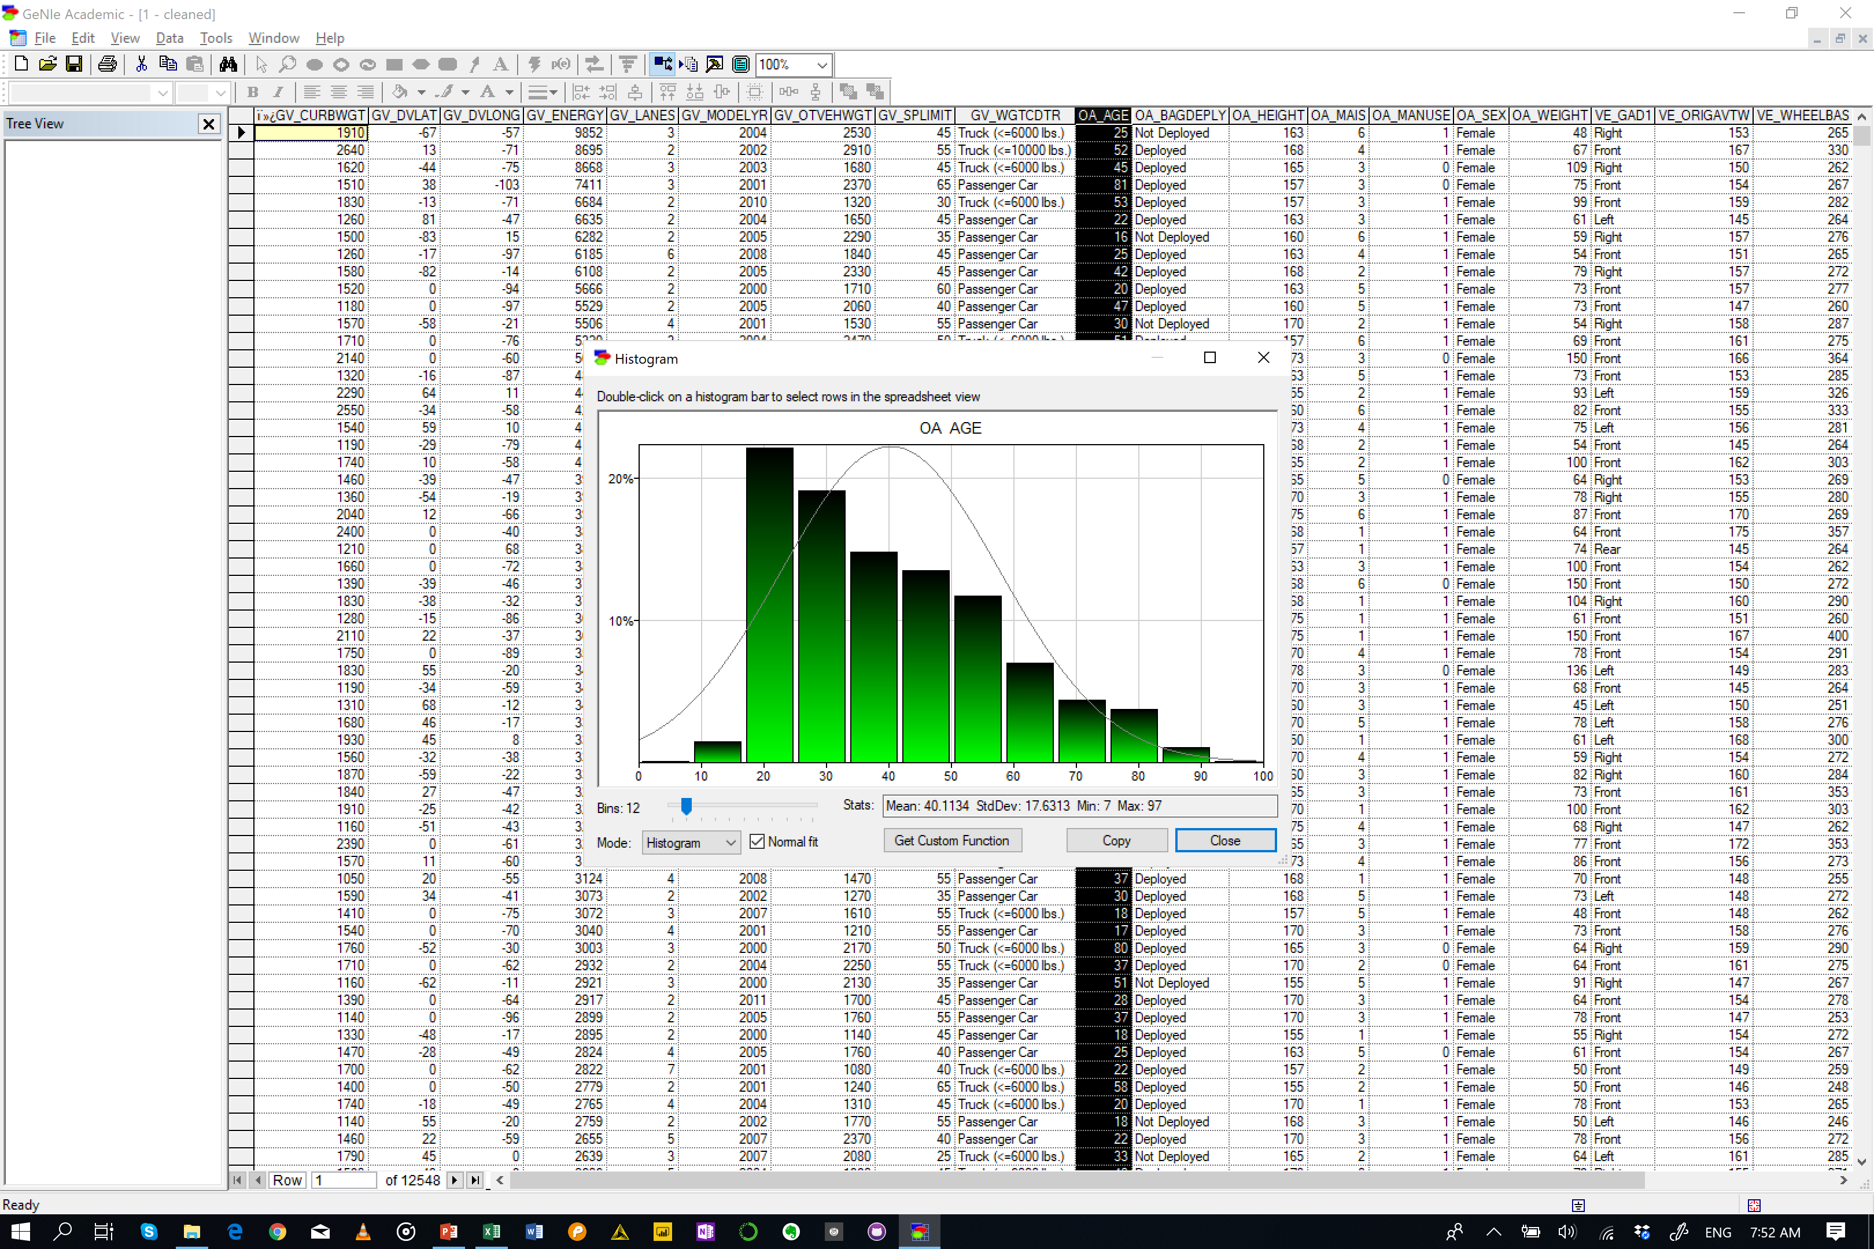
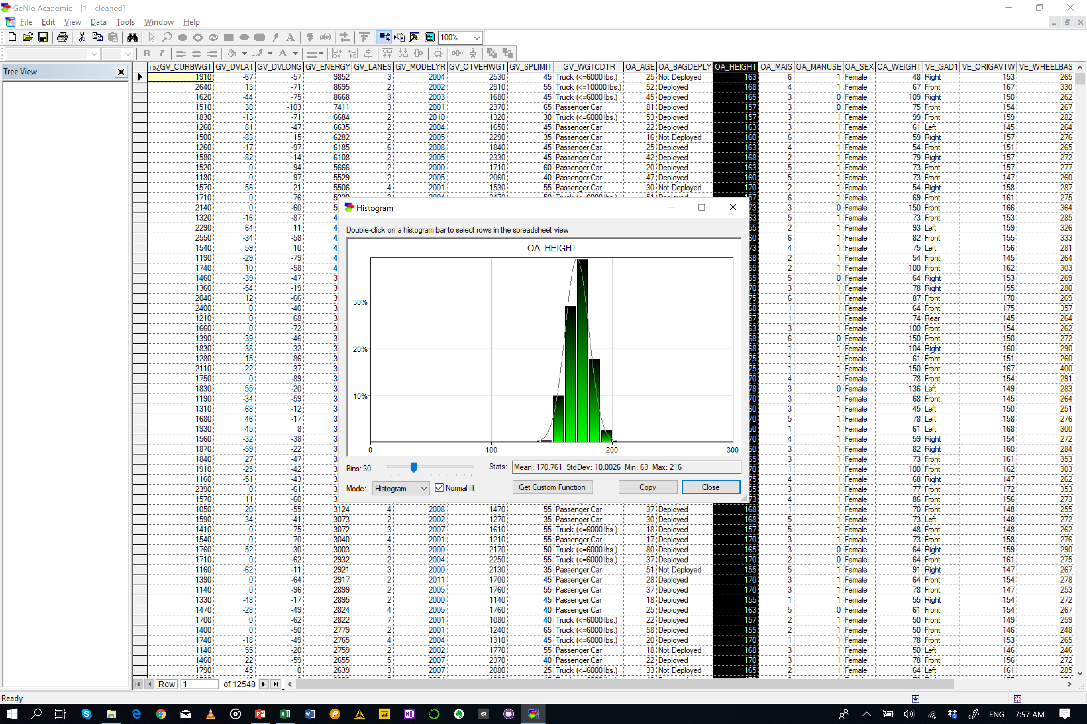
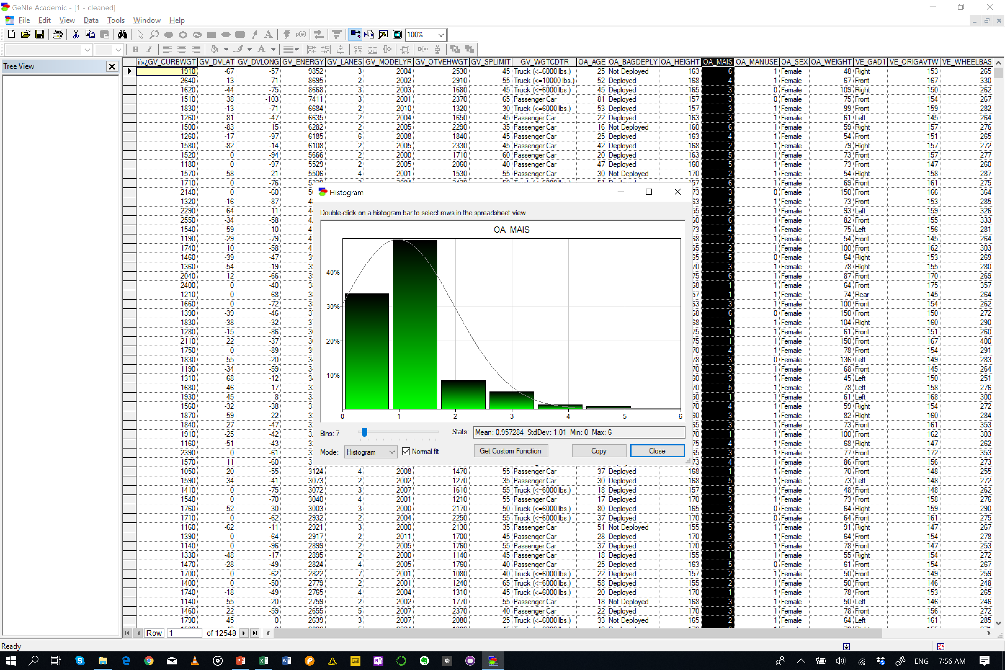
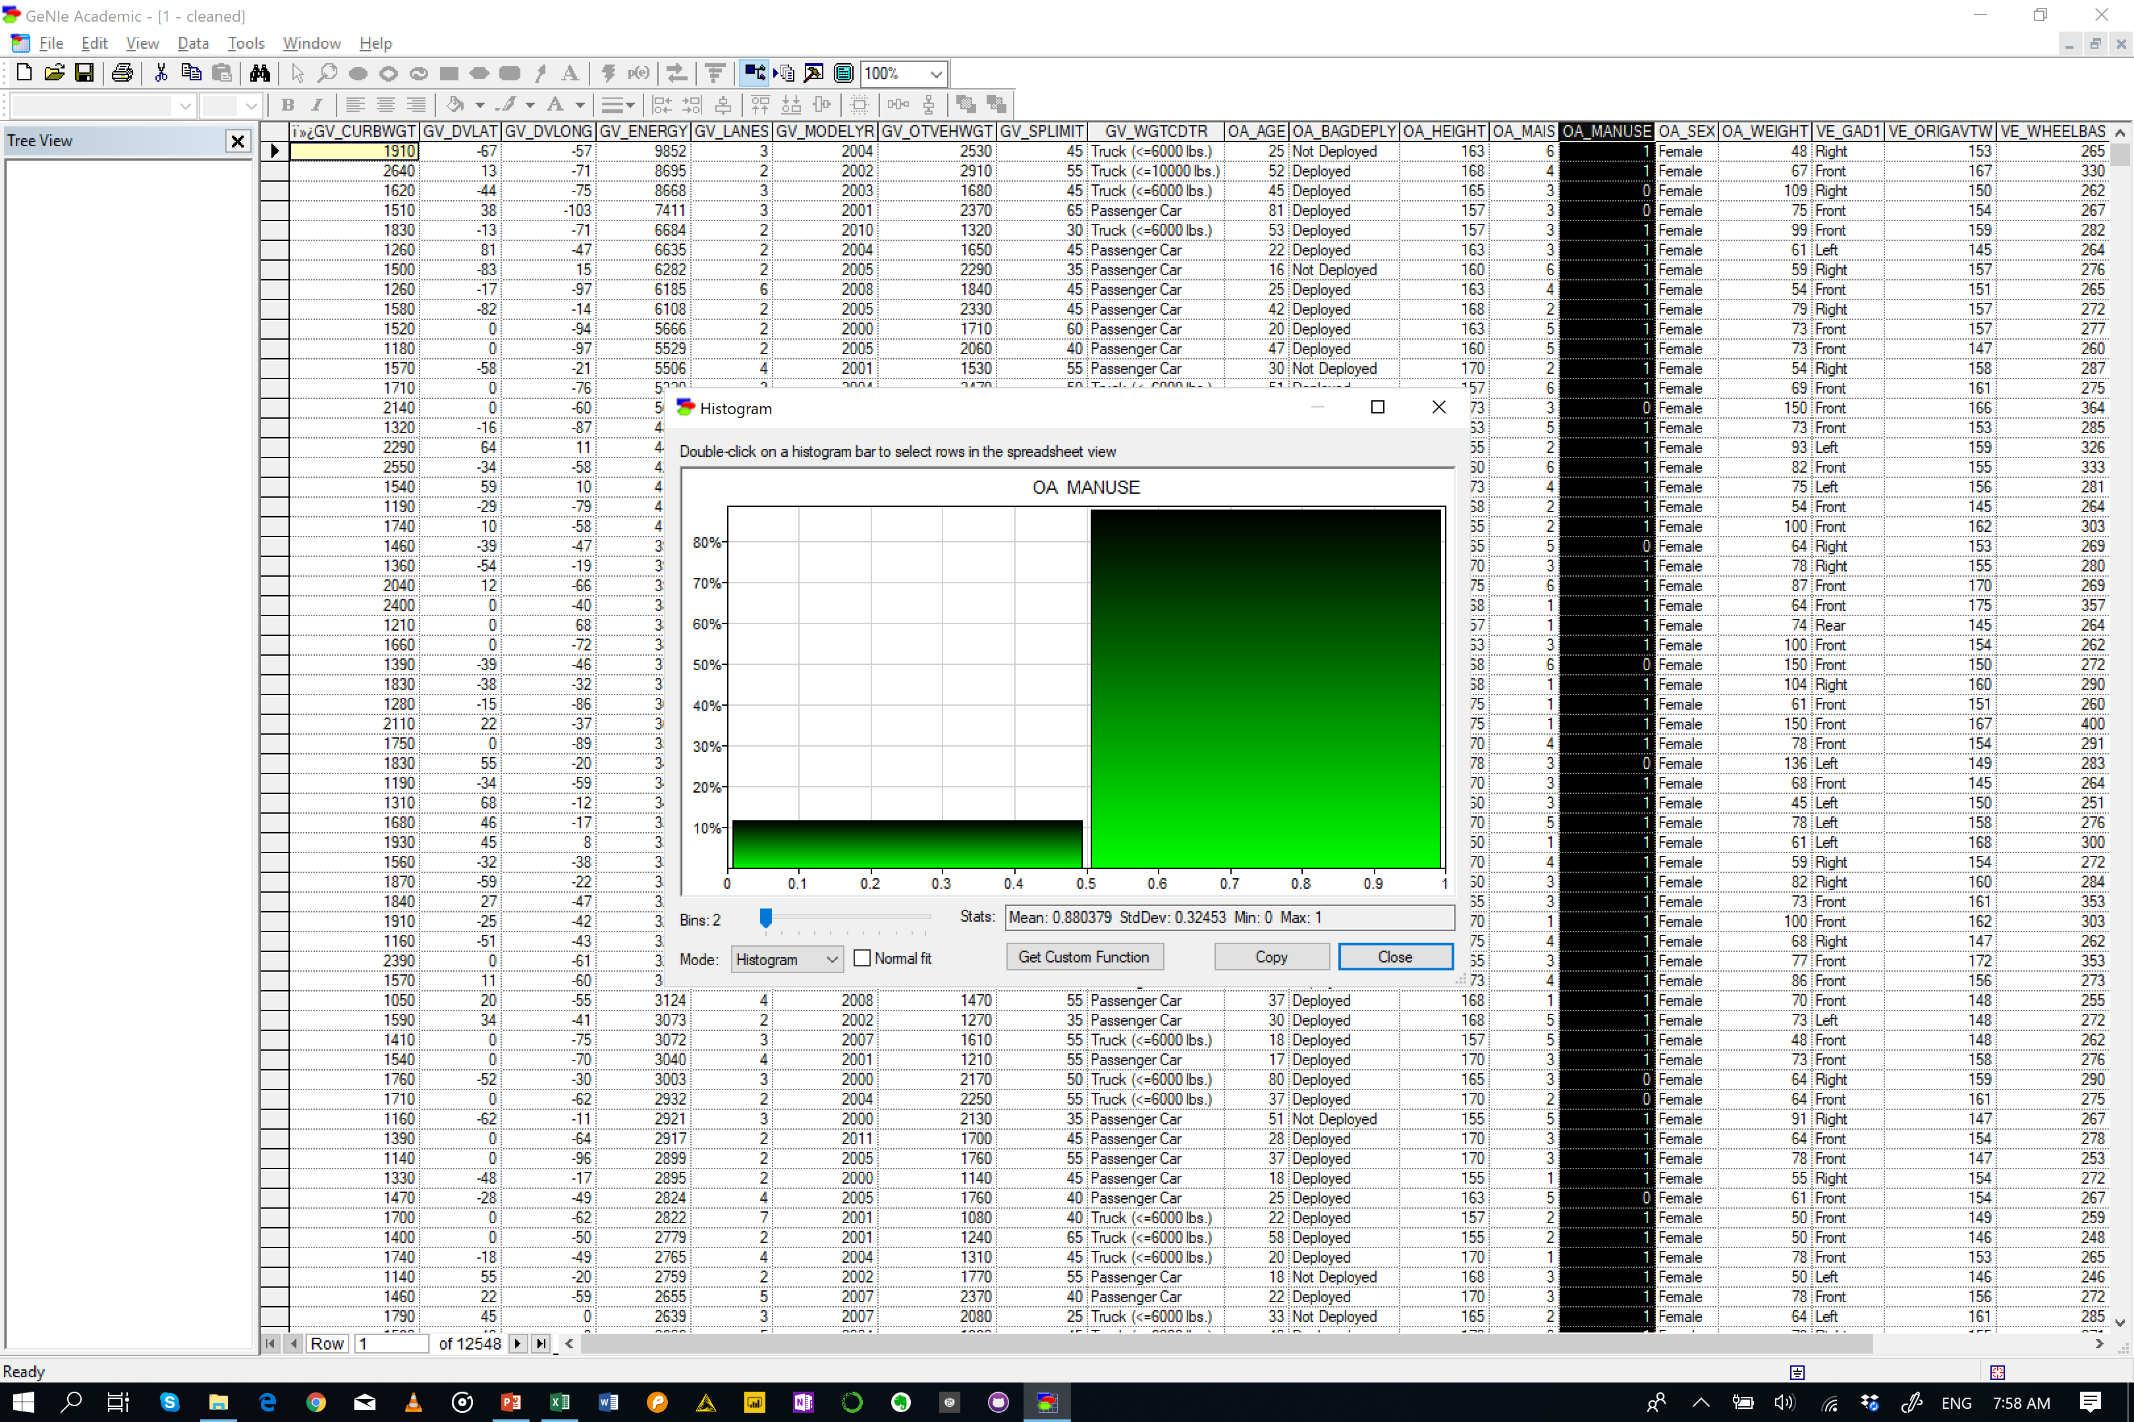

Slide 2
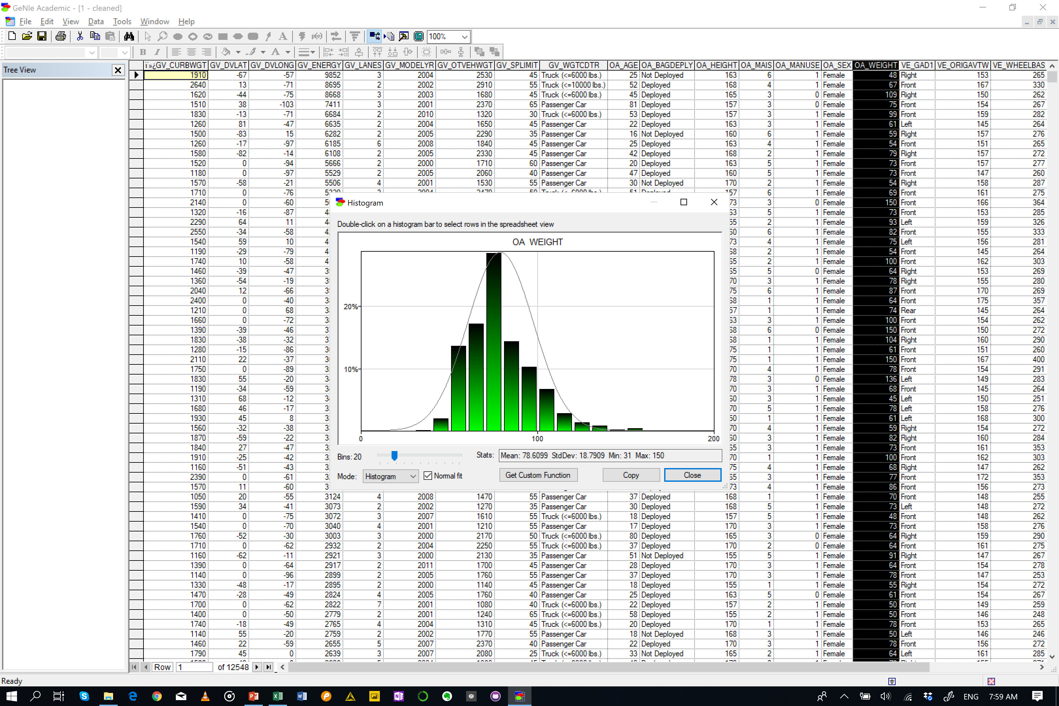
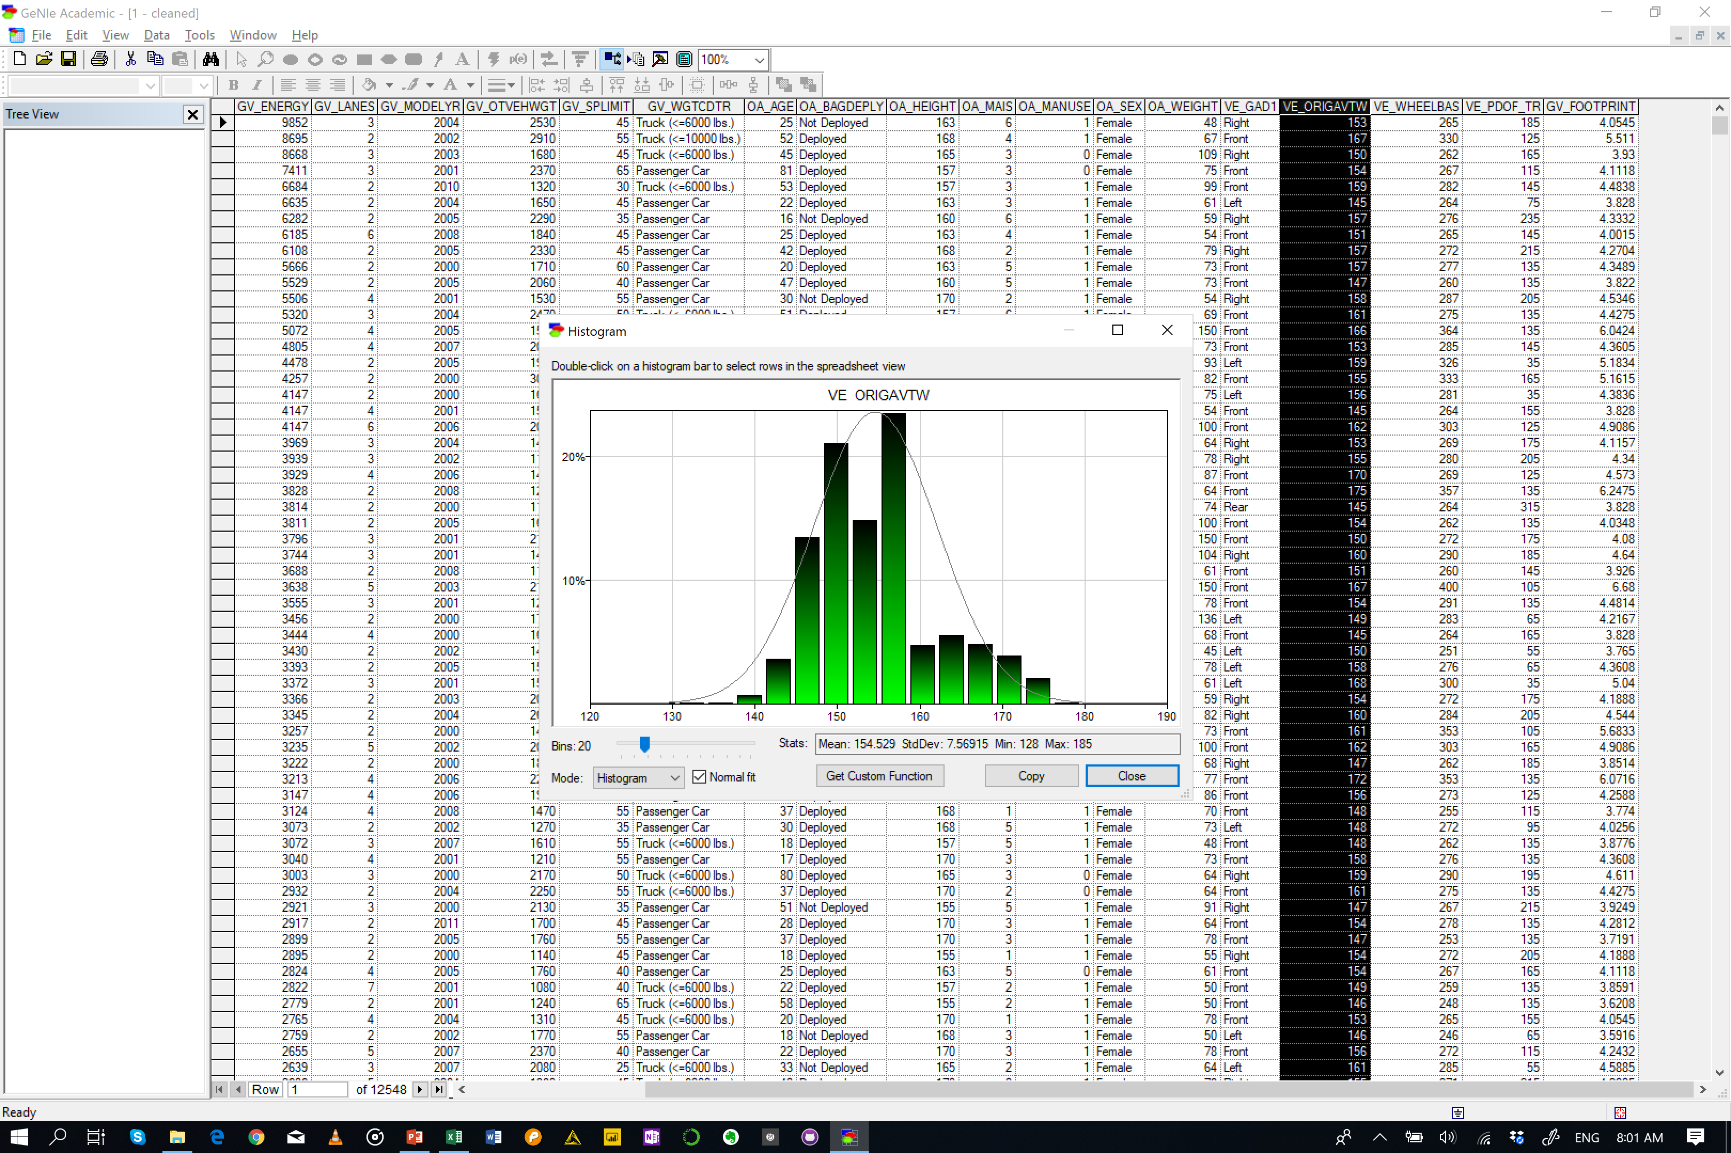
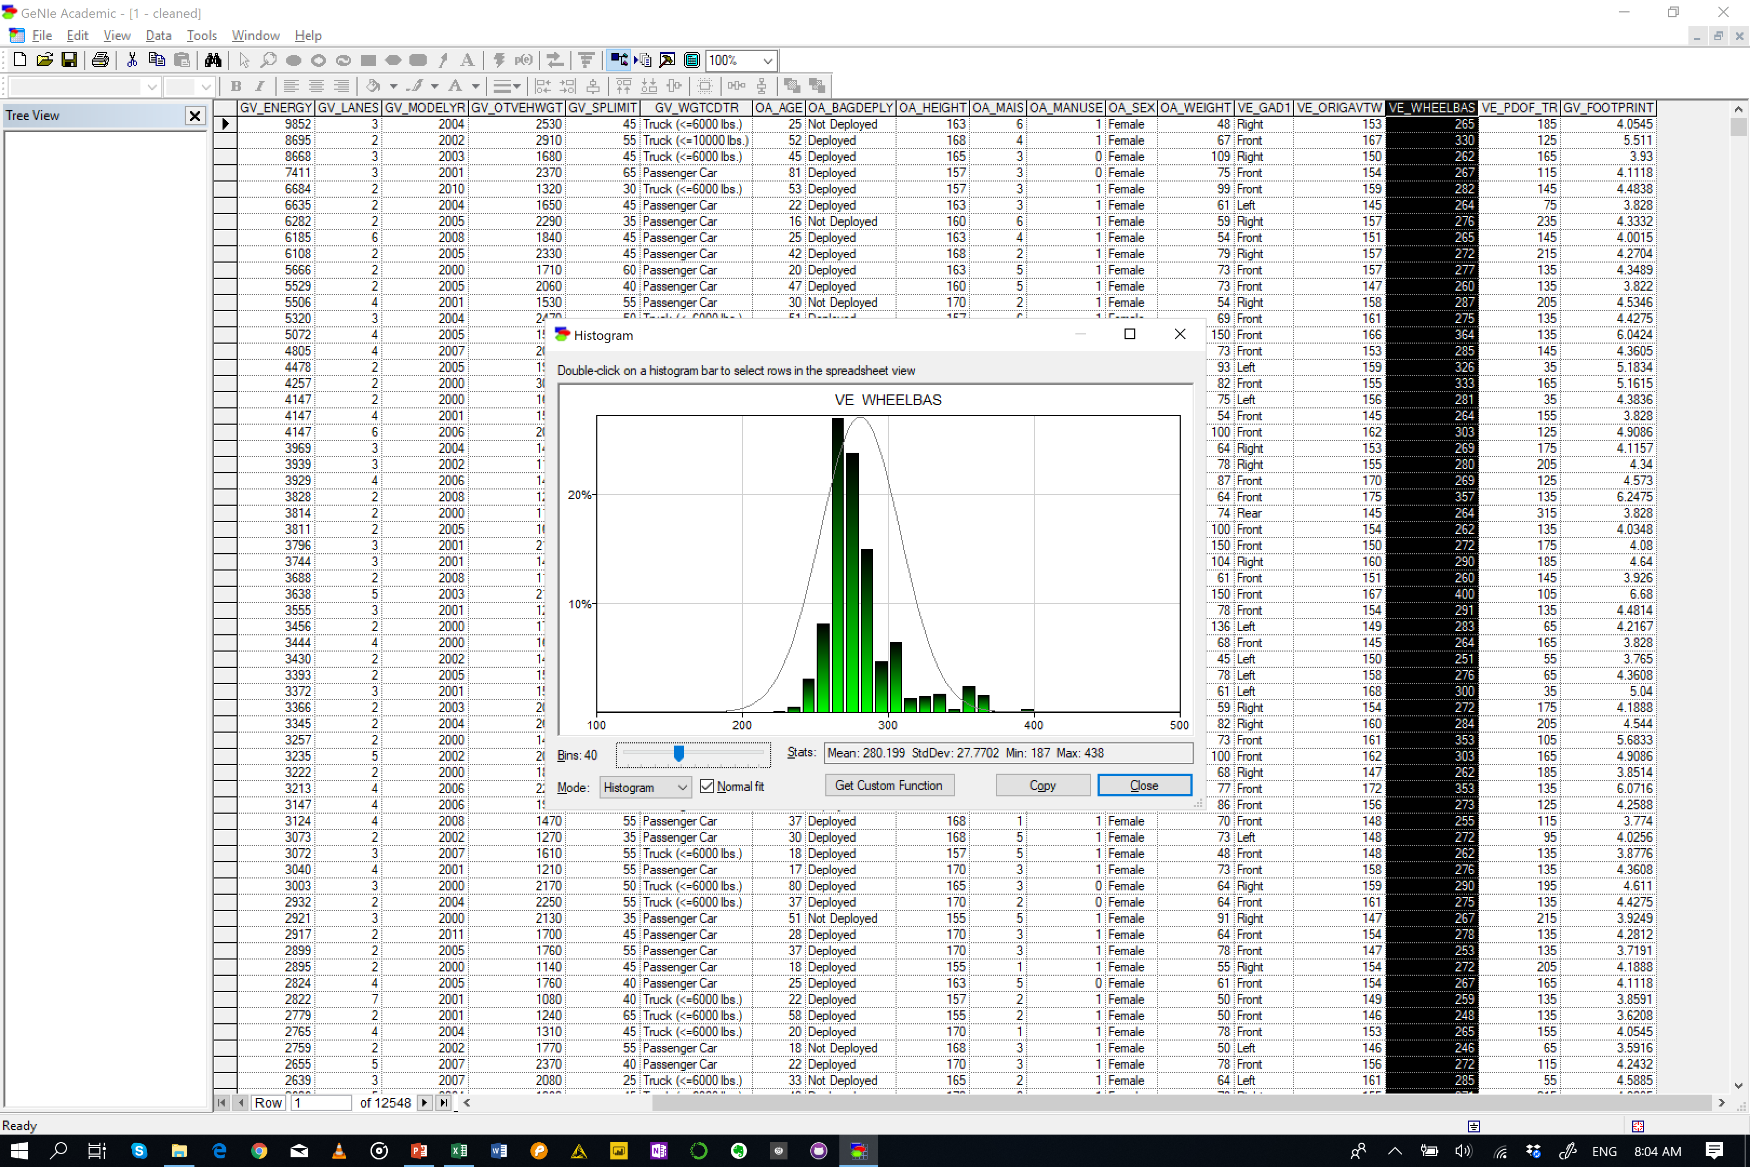
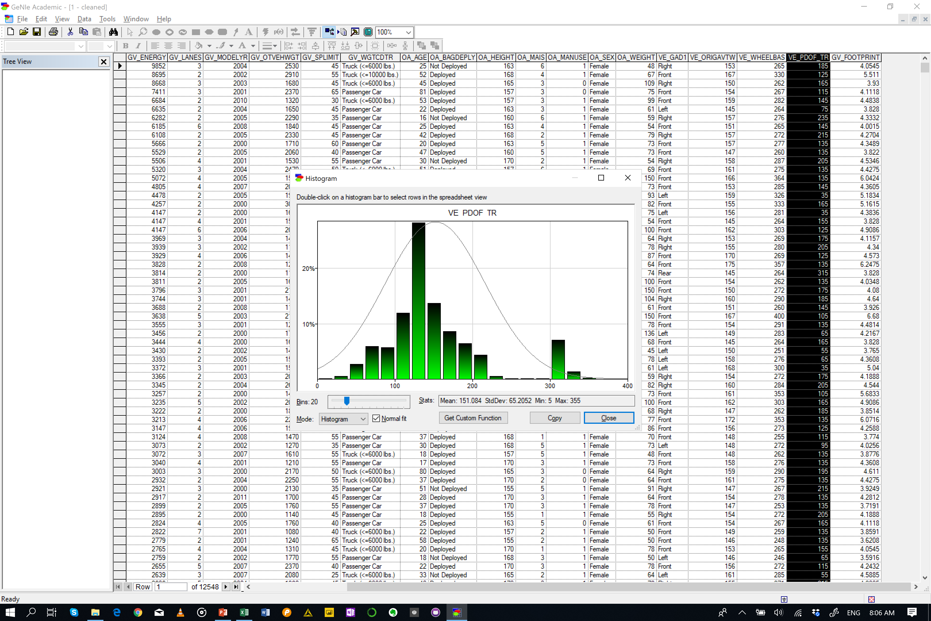
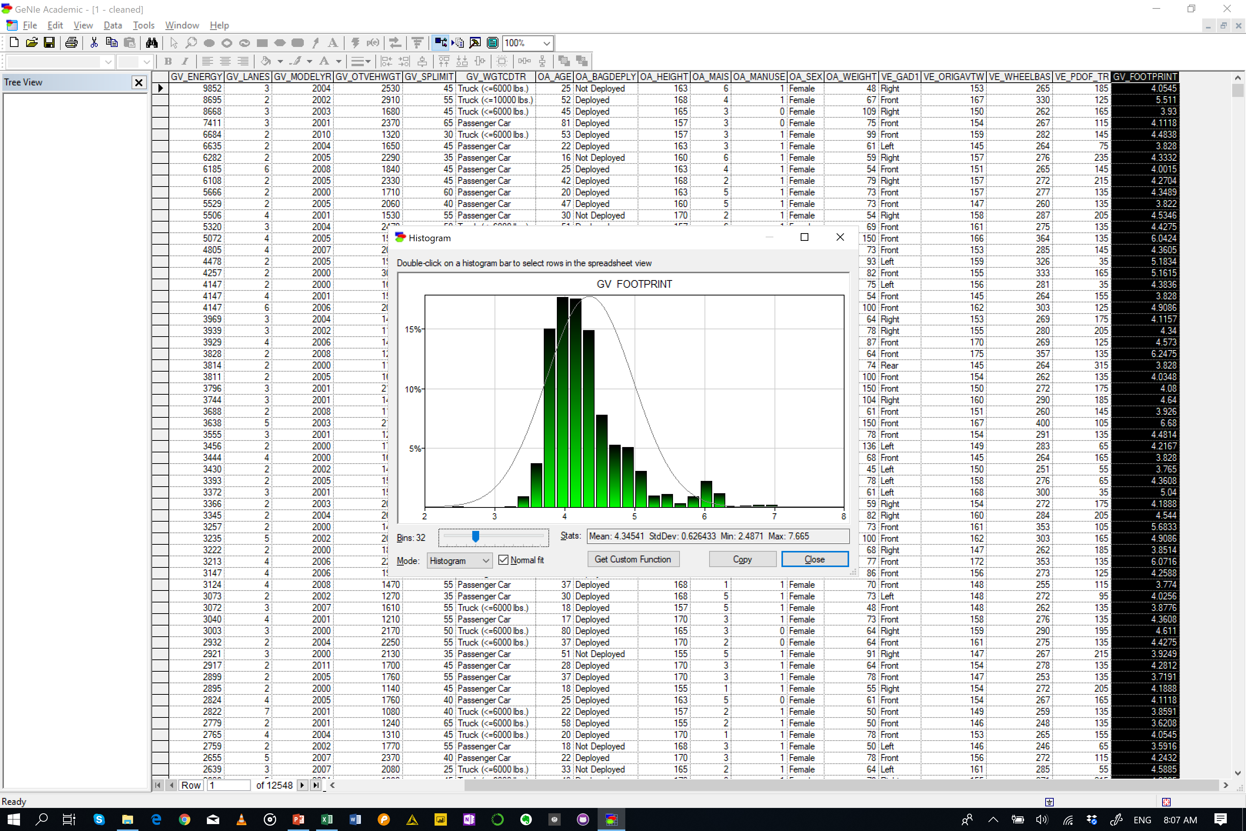

Slide 3
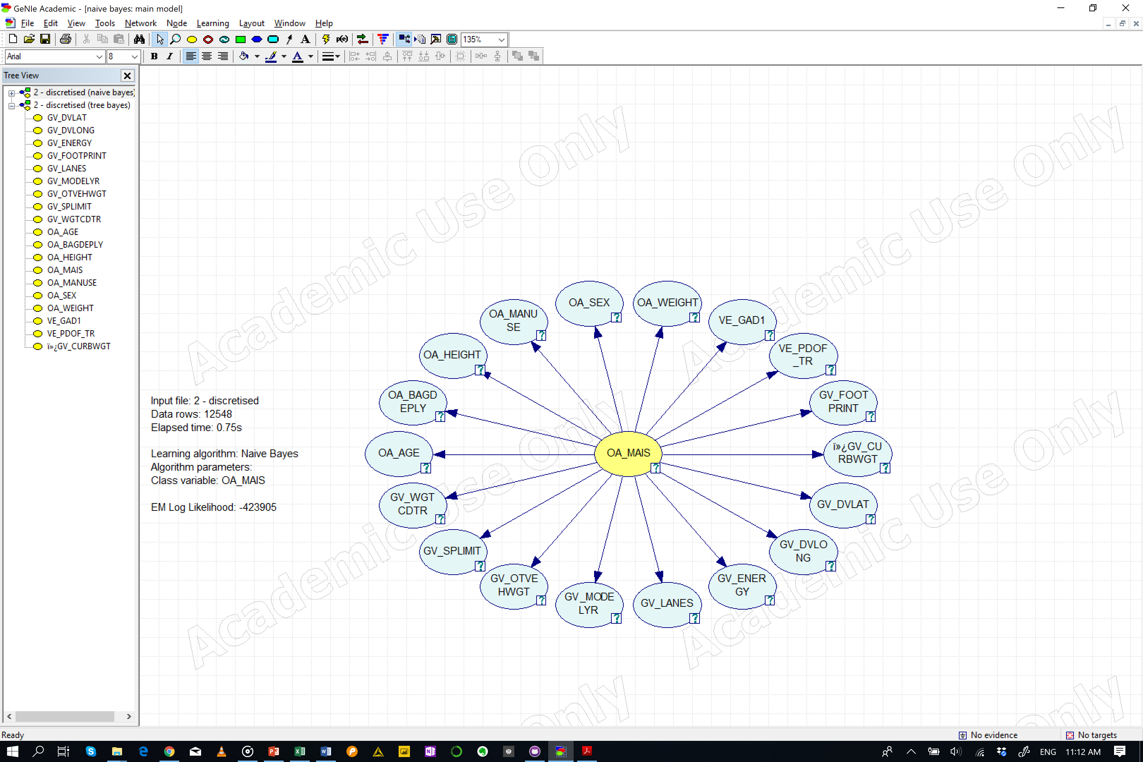
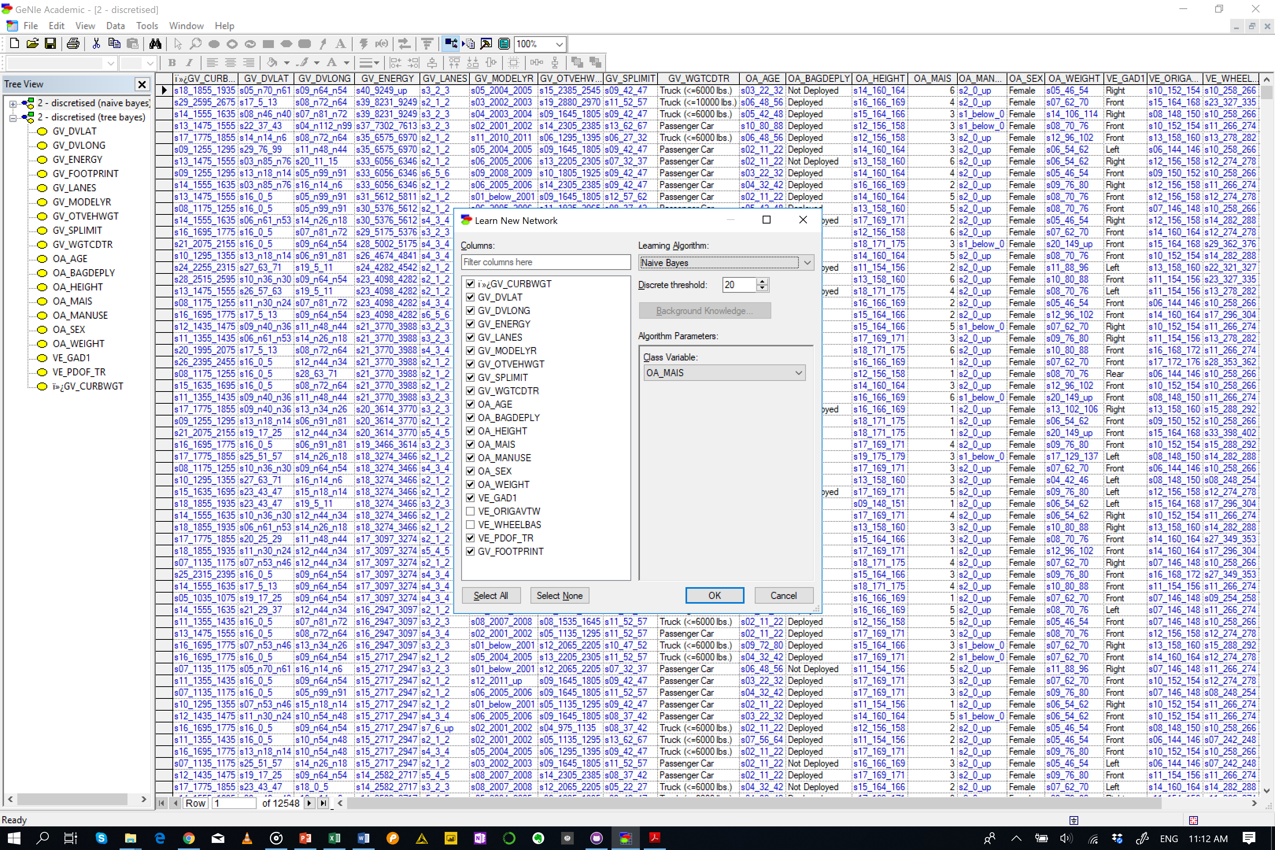
Naïve Bayes

Slide 4
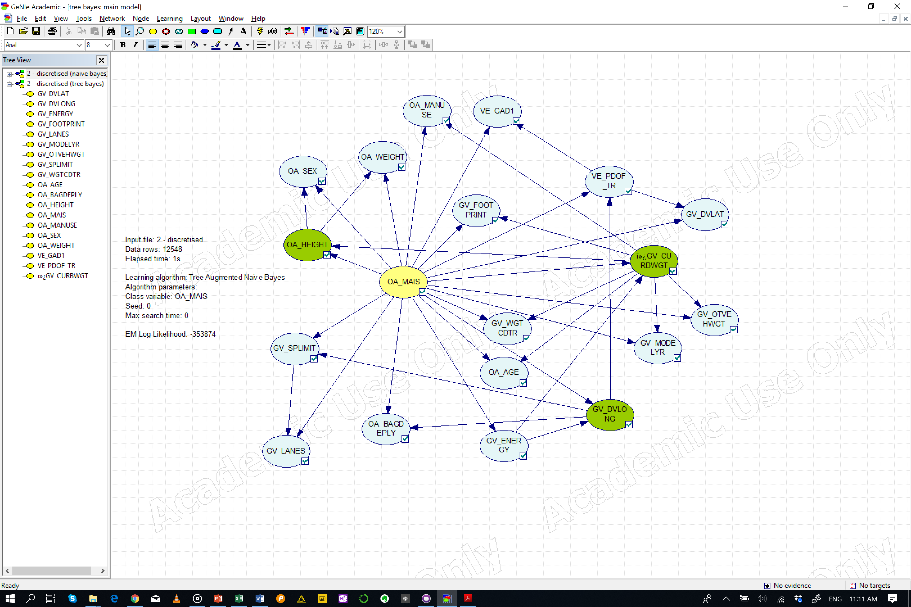
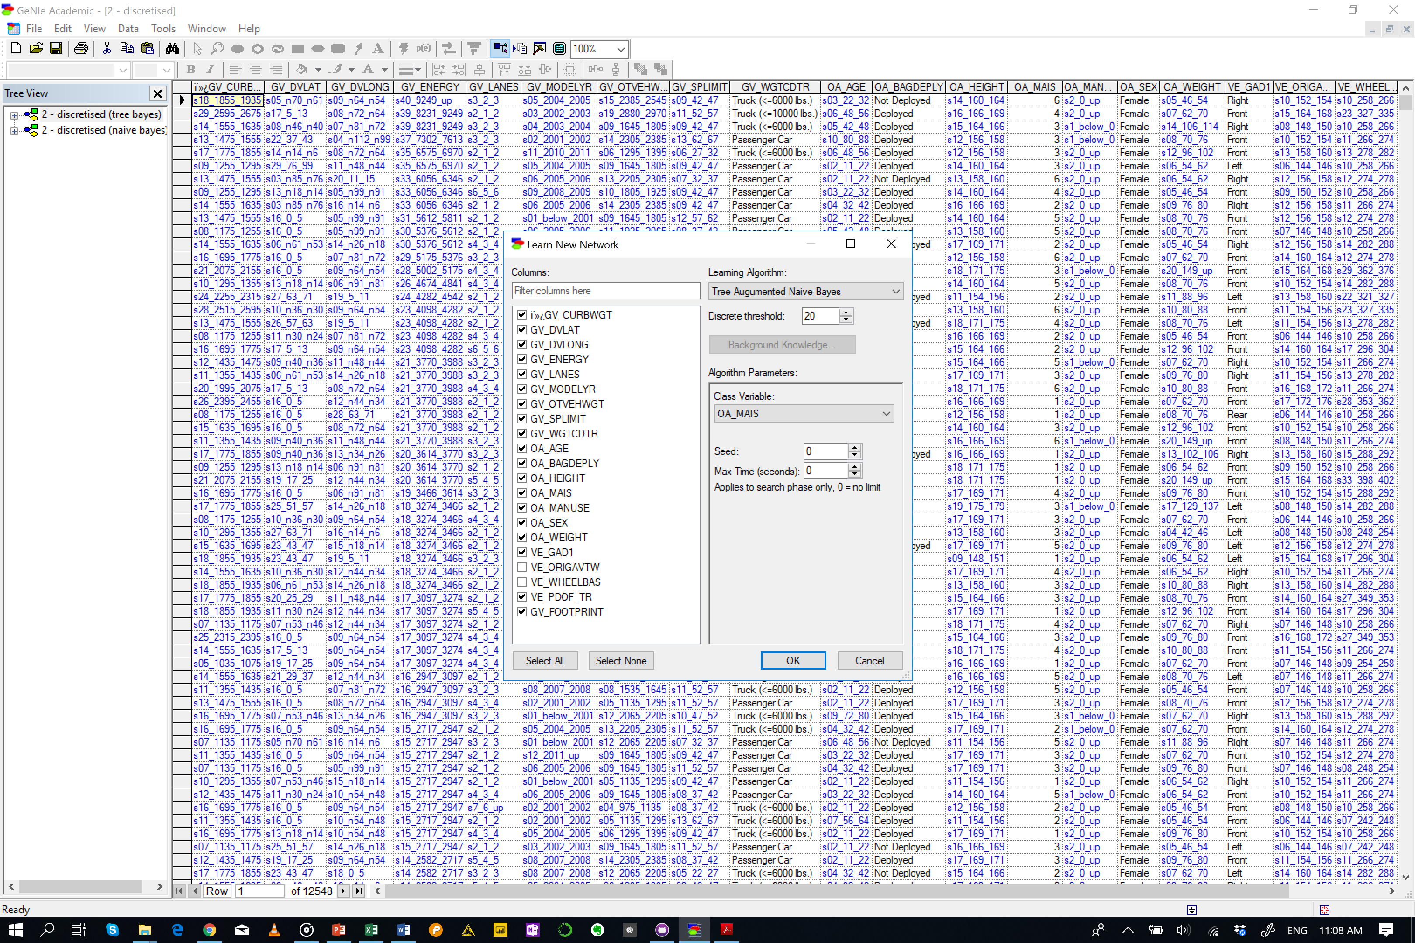
Tree Augmented Bayesian Networks

Slide 5
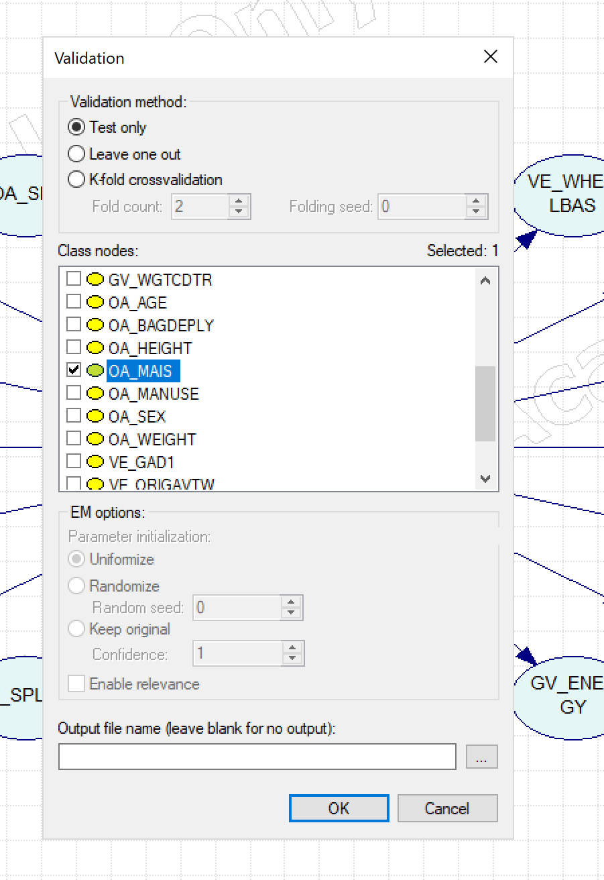
Test
Default
Naïve Bayes
Accuracy
OA_MAIS = 0.558017 (7002/12548)
State0 = 0.548531 (2334/4255)
State1 = 0.681605 (4213/6181)
State2 = 0.0695733 (75/1078)
State3 = 0.332834 (222/667)
State4 = 0.371859 (74/199)
State5 = 0.423077 (55/130)
State6 = 0.763158 (29/38)
 |  | Predicted
 |  | s1_below_0 | s2_0_1 | s3_1_2 | s4_2_3 | s5_3_4 | s6_4_5 | s7_5_up
Actual | s1_below_0 | 2334 | 1791 | 31 | 66 | 23 | 10 | 0
 | s2_0_1 | 1531 | 4213 | 90 | 197 | 95 | 54 | 1
 | s3_1_2 | 139 | 672 | 75 | 117 | 49 | 21 | 5
 | s4_2_3 | 48 | 294 | 24 | 222 | 53 | 22 | 4
 | s5_3_4 | 10 | 55 | 8 | 40 | 74 | 12 | 0
 | s6_4_5 | 5 | 28 | 1 | 22 | 15 | 55 | 4
 | s7_5_up | 1 | 3 | 0 | 2 | 0 | 3 | 29

Slide 6
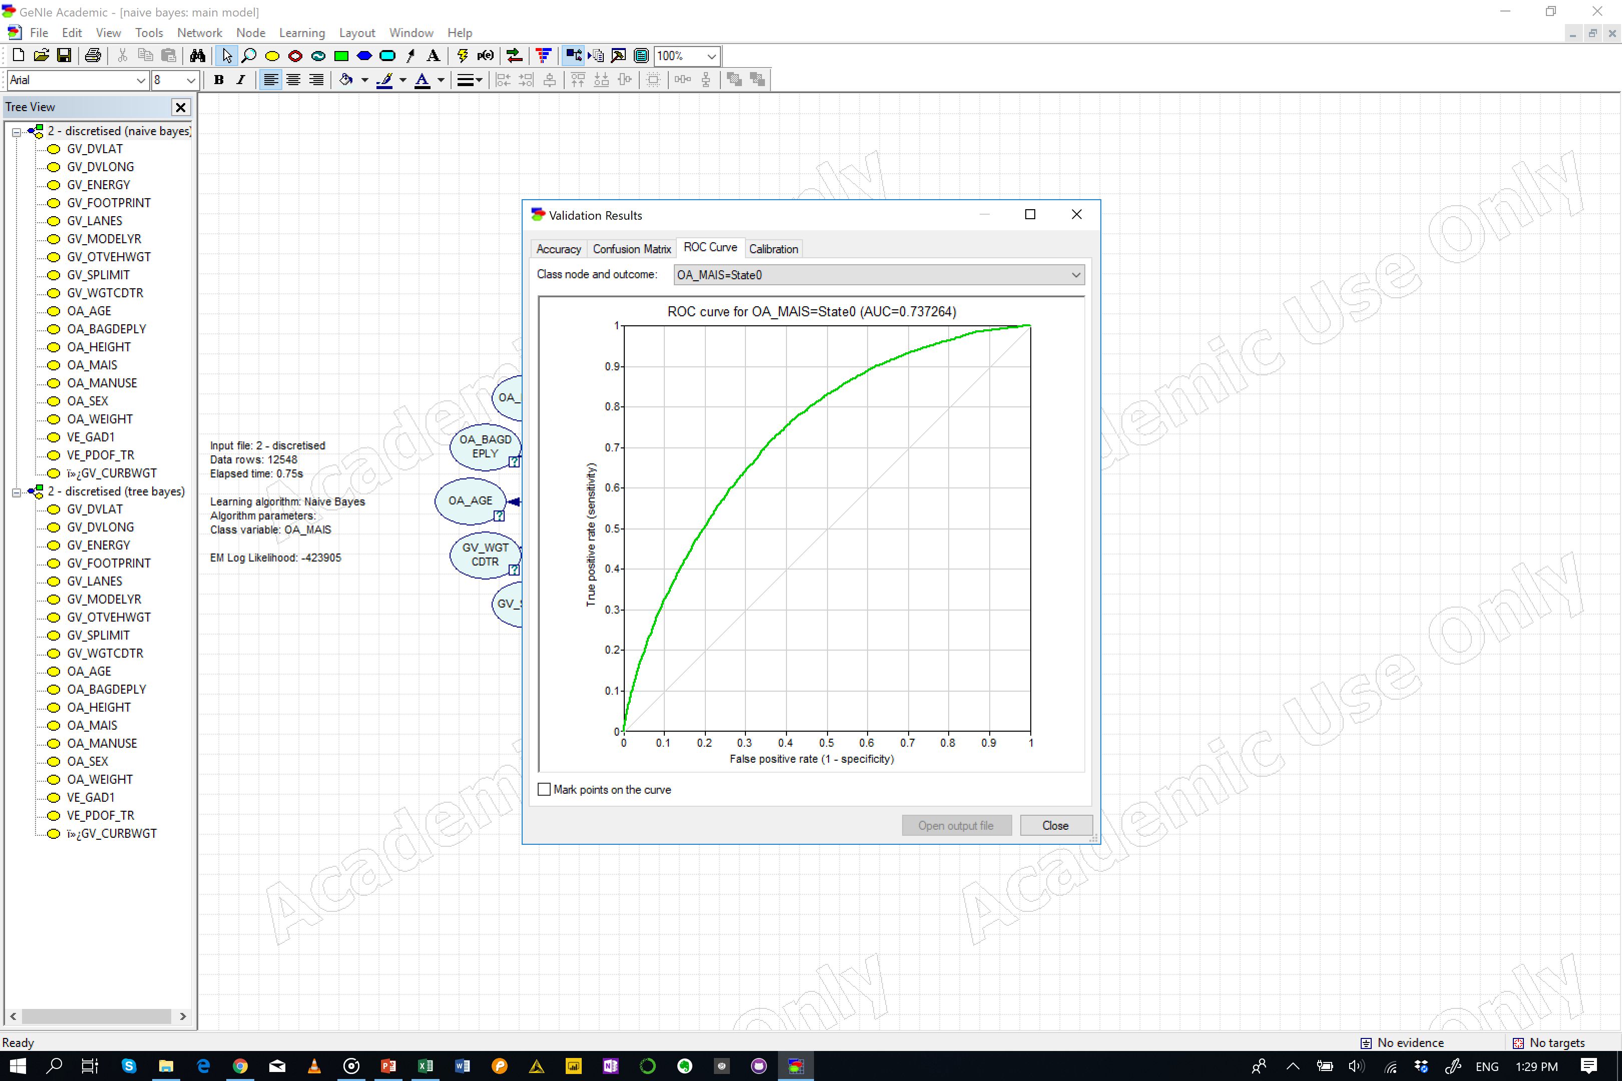
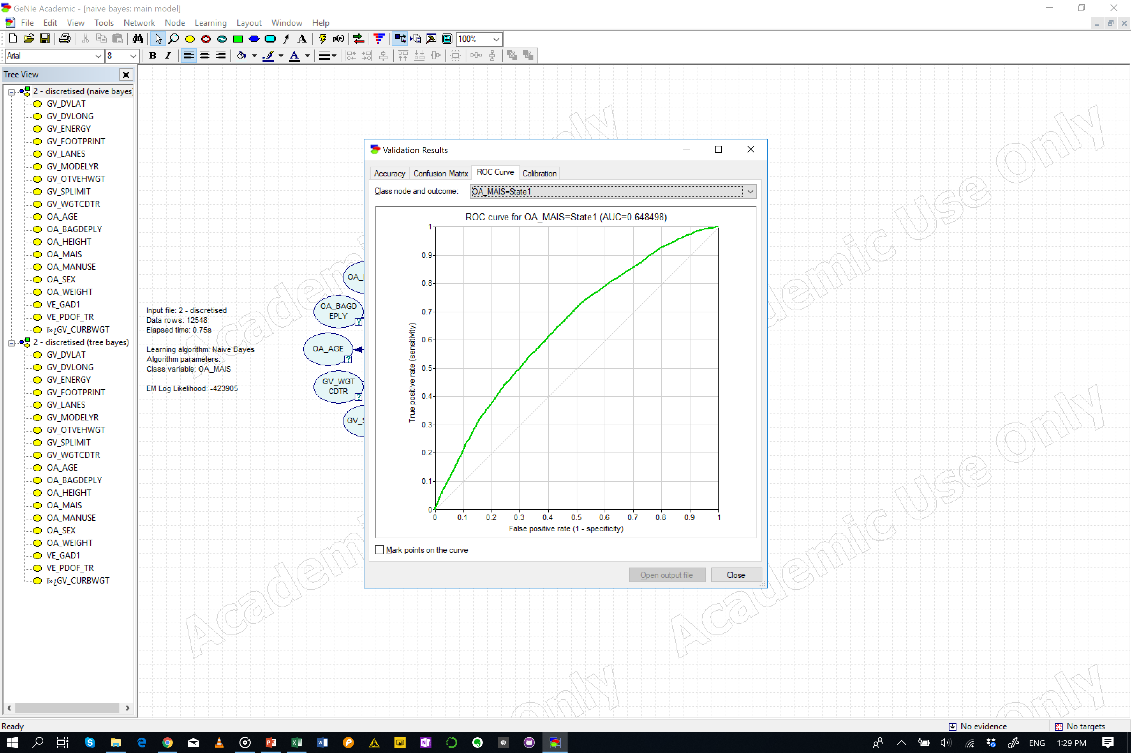


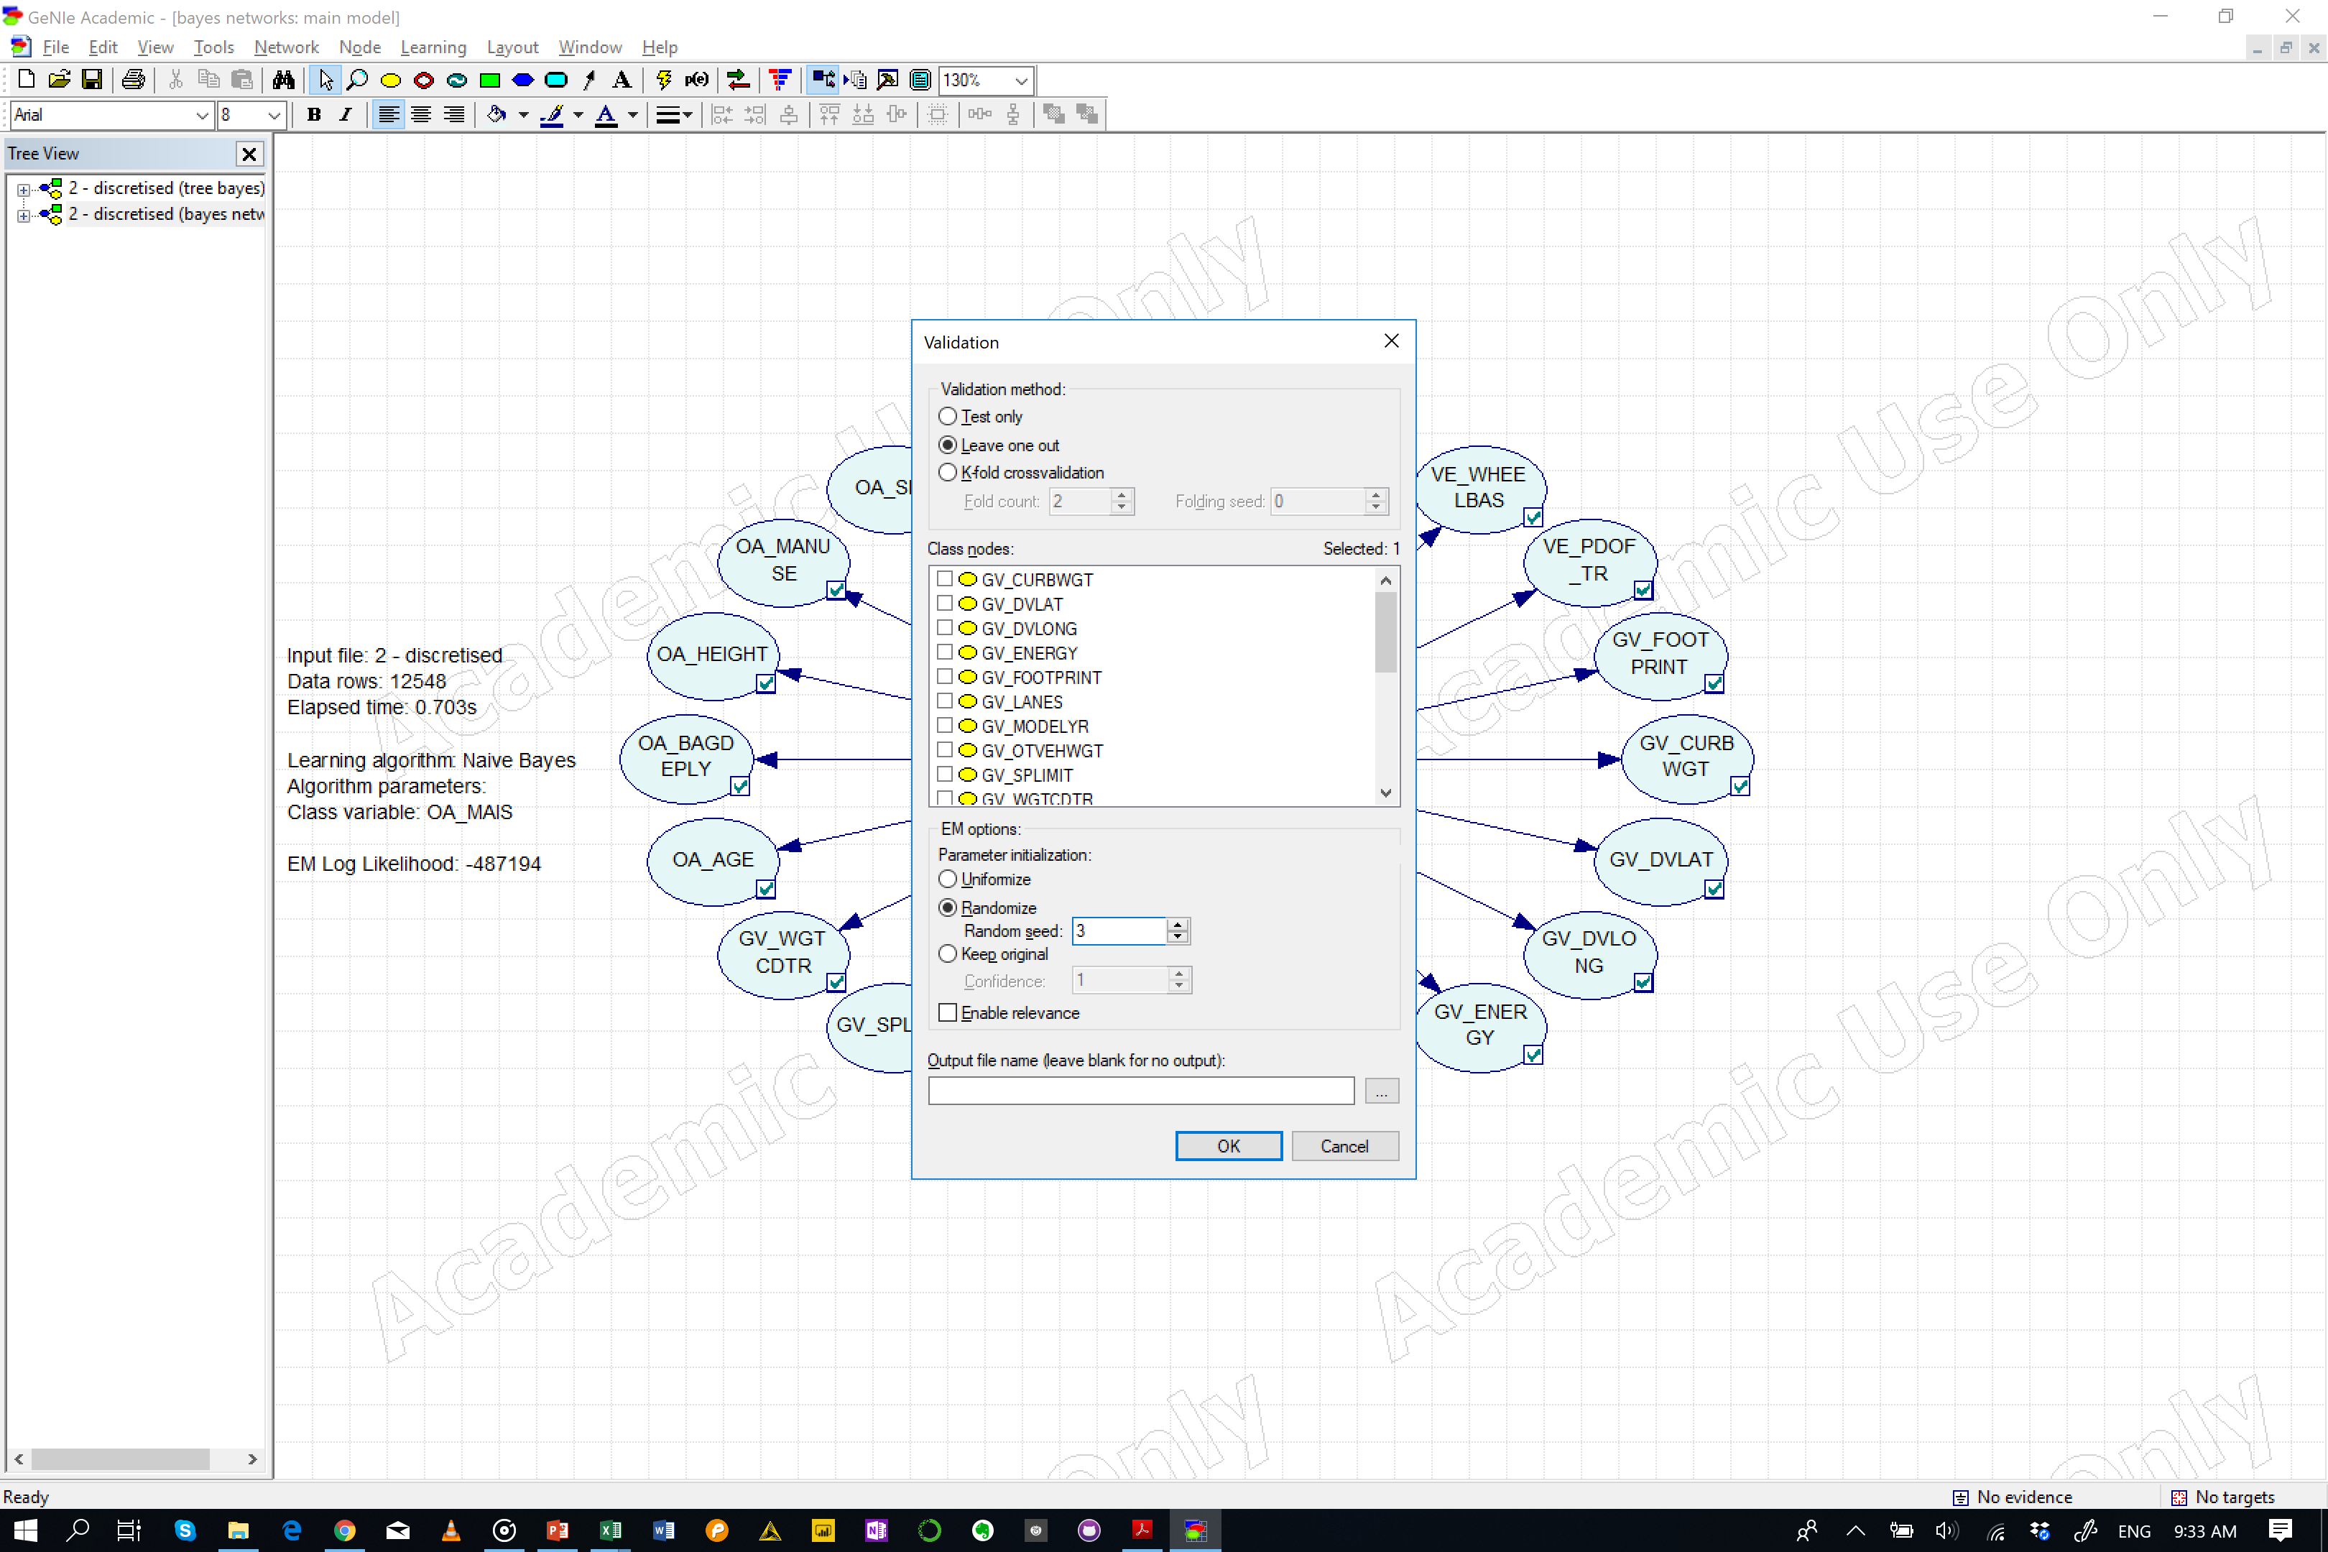


Test
Leave one out
Naïve Bayes
Accuracy
OA_MAIS = 0.532435 (6681/12548)
State0 = 0.52926 (2252/4255)
State1 = 0.670118 (4142/6181)
State2 = 0.0398887 (43/1078)
State3 = 0.26087 (174/667)
State4 = 0.20603 (41/199)
State5 = 0.184615 (24/130)
State6 = 0.131579 (5/38)
 |  | Predicted
 |  | s1_below_0 | s2_0_1 | s3_1_2 | s4_2_3 | s5_3_4 | s6_4_5 | s7_5_up
Actual | s1_below_0 | 2252 | 1864 | 33 | 69 | 27 | 10 | 0
 | s2_0_1 | 1581 | 4142 | 98 | 206 | 97 | 55 | 2
 | s3_1_2 | 141 | 688 | 43 | 129 | 50 | 22 | 5
 | s4_2_3 | 50 | 305 | 48 | 174 | 57 | 26 | 7
 | s5_3_4 | 13 | 65 | 12 | 46 | 41 | 21 | 1
 | s6_4_5 | 5 | 33 | 5 | 29 | 28 | 24 | 6
 | s7_5_up | 1 | 3 | 5 | 11 | 4 | 9 | 5

Slide 7
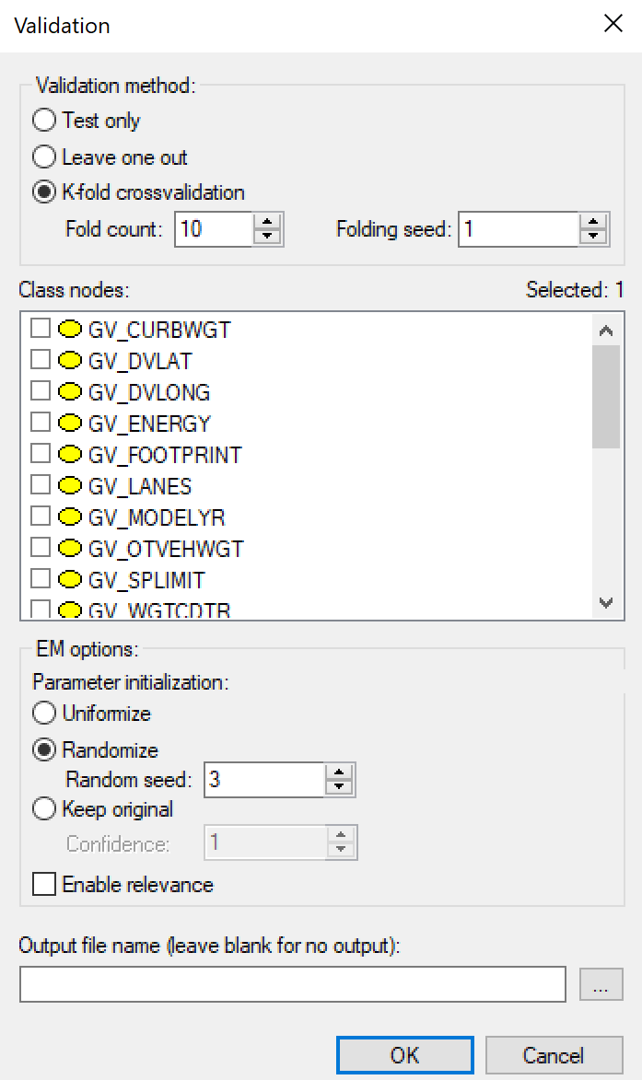
Test
K-fold (10)
Naïve Bayes
Accuracy
OA_MAIS = 0.531081 (6664/12548)
State0 = 0.526439 (2240/4255)
State1 = 0.669633 (4139/6181)
State2 = 0.0380334 (41/1078)
State3 = 0.263868 (176/667)
State4 = 0.201005 (40/199)
State5 = 0.169231 (22/130)
State6 = 0.157895 (6/38)
 |  | Predicted
 |  | s1_below_0 | s2_0_1 | s3_1_2 | s4_2_3 | s5_3_4 | s6_4_5 | s7_5_up
Actual | s1_below_0 | 2240 | 1877 | 34 | 69 | 26 | 9 | 0
 | s2_0_1 | 1584 | 4139 | 101 | 208 | 99 | 48 | 2
 | s3_1_2 | 145 | 684 | 41 | 130 | 49 | 23 | 6
 | s4_2_3 | 50 | 309 | 47 | 176 | 54 | 26 | 5
 | s5_3_4 | 12 | 62 | 15 | 46 | 40 | 23 | 1
 | s6_4_5 | 5 | 33 | 4 | 31 | 30 | 22 | 5
 | s7_5_up | 1 | 3 | 4 | 12 | 2 | 10 | 6

Slide 8

Test
K-fold (20)
Naïve Bayes
Accuracy
OA_MAIS = 0.532037 (6676/12548)
State0 = 0.52879 (2250/4255)
State1 = 0.669471 (4138/6181)
State2 = 0.041744 (45/1078)
State3 = 0.265367 (177/667)
State4 = 0.201005 (40/199)
State5 = 0.153846 (20/130)
State6 = 0.157895 (6/38)
 |  | Predicted
 |  | s1_below_0 | s2_0_1 | s3_1_2 | s4_2_3 | s5_3_4 | s6_4_5 | s7_5_up
Actual | s1_below_0 | 2250 | 1871 | 31 | 71 | 25 | 7 | 0
 | s2_0_1 | 1587 | 4138 | 98 | 209 | 99 | 48 | 2
 | s3_1_2 | 142 | 682 | 45 | 131 | 48 | 25 | 5
 | s4_2_3 | 48 | 308 | 47 | 177 | 56 | 26 | 5
 | s5_3_4 | 12 | 64 | 13 | 45 | 40 | 24 | 1
 | s6_4_5 | 5 | 33 | 4 | 29 | 33 | 20 | 6
 | s7_5_up | 1 | 3 | 4 | 13 | 2 | 9 | 6

Slide 9
Test
Default
Tree Augmented Bayes
Accuracy
OA_MAIS = 0.698199 (8761/12548)
State0 = 0.663925 (2825/4255)
State1 = 0.772691 (4776/6181)
State2 = 0.397032 (428/1078)
State3 = 0.626687 (418/667)
State4 = 0.844221 (168/199)
State5 = 0.838462 (109/130)
State6 = 0.973684 (37/38)
 |  | Predicted
 |  | s1_below_0 | s2_0_1 | s3_1_2 | s4_2_3 | s5_3_4 | s6_4_5 | s7_5_up
Actual | s1_below_0 | 2825 | 1314 | 56 | 51 | 5 | 4 | 0
 | s2_0_1 | 1109 | 4776 | 154 | 109 | 23 | 9 | 1
 | s3_1_2 | 122 | 471 | 428 | 42 | 12 | 2 | 1
 | s4_2_3 | 42 | 174 | 20 | 418 | 12 | 1 | 0
 | s5_3_4 | 6 | 16 | 3 | 6 | 168 | 0 | 0
 | s6_4_5 | 4 | 10 | 2 | 5 | 0 | 109 | 0
 | s7_5_up | 0 | 1 | 0 | 0 | 0 | 0 | 37

Slide 10
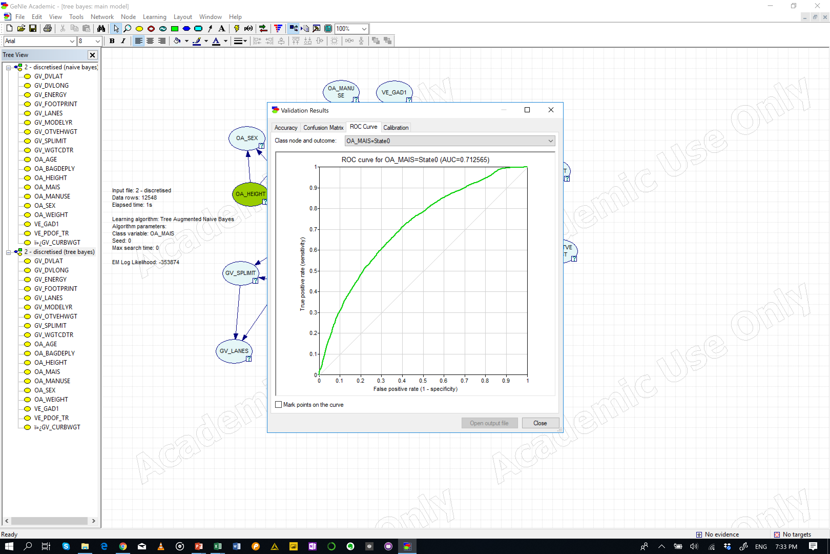


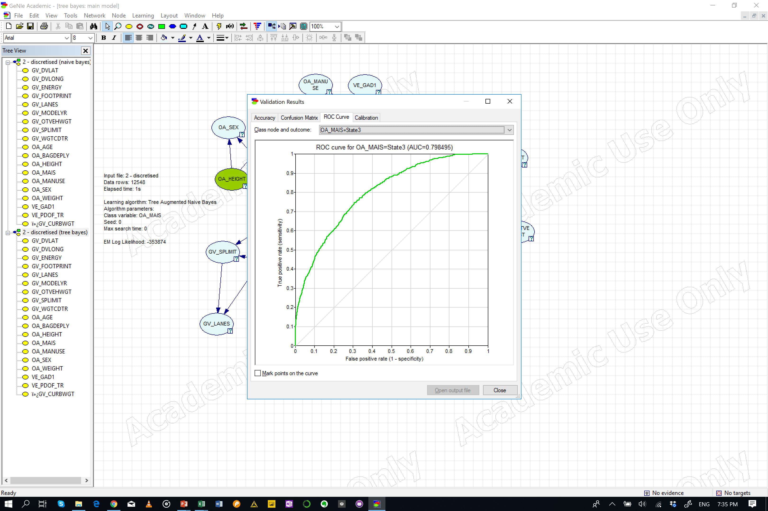
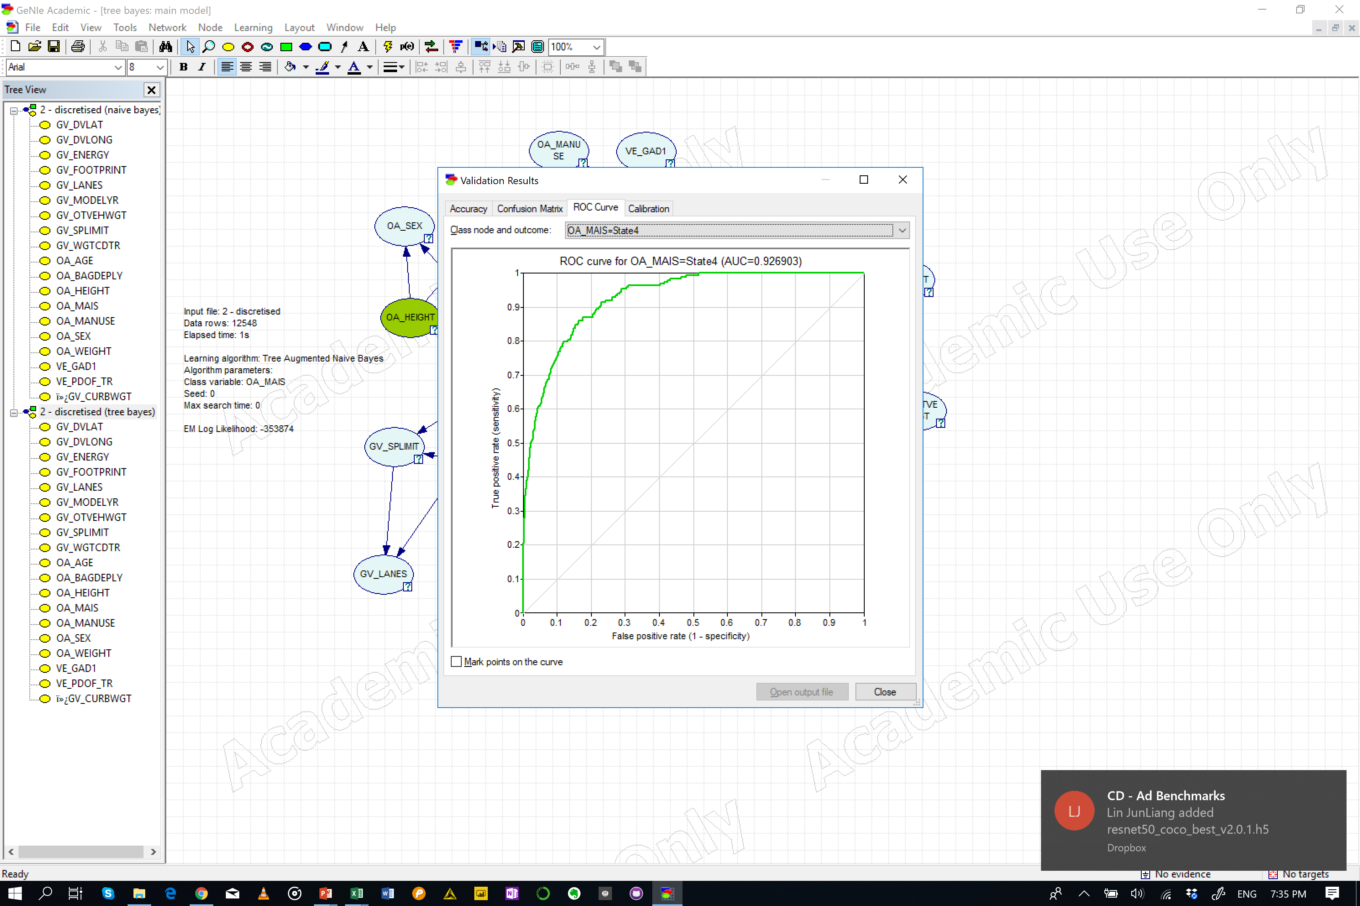
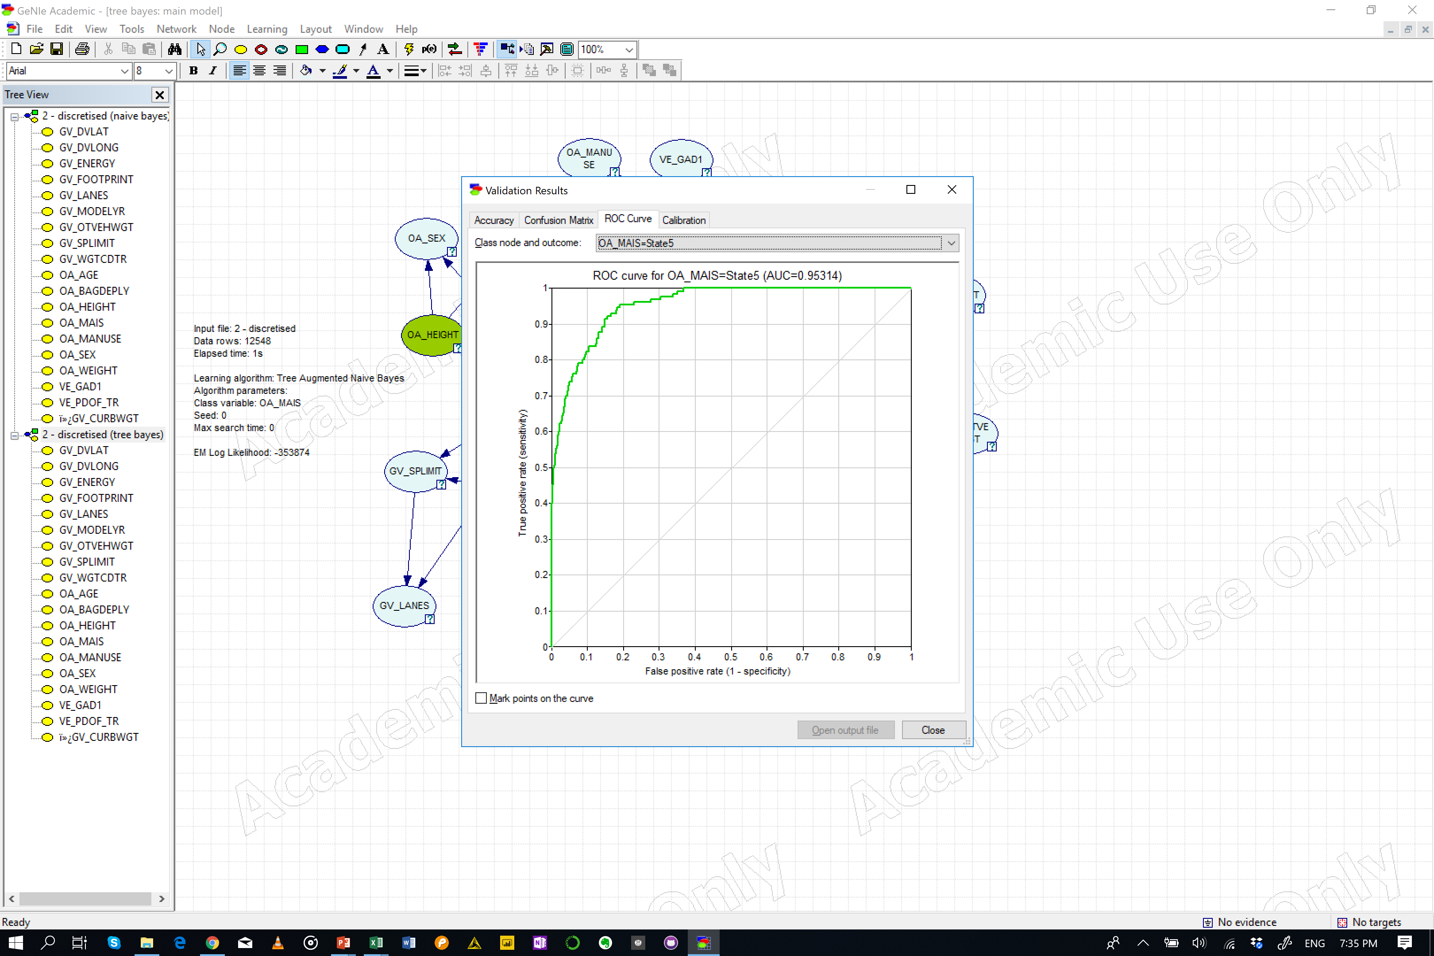
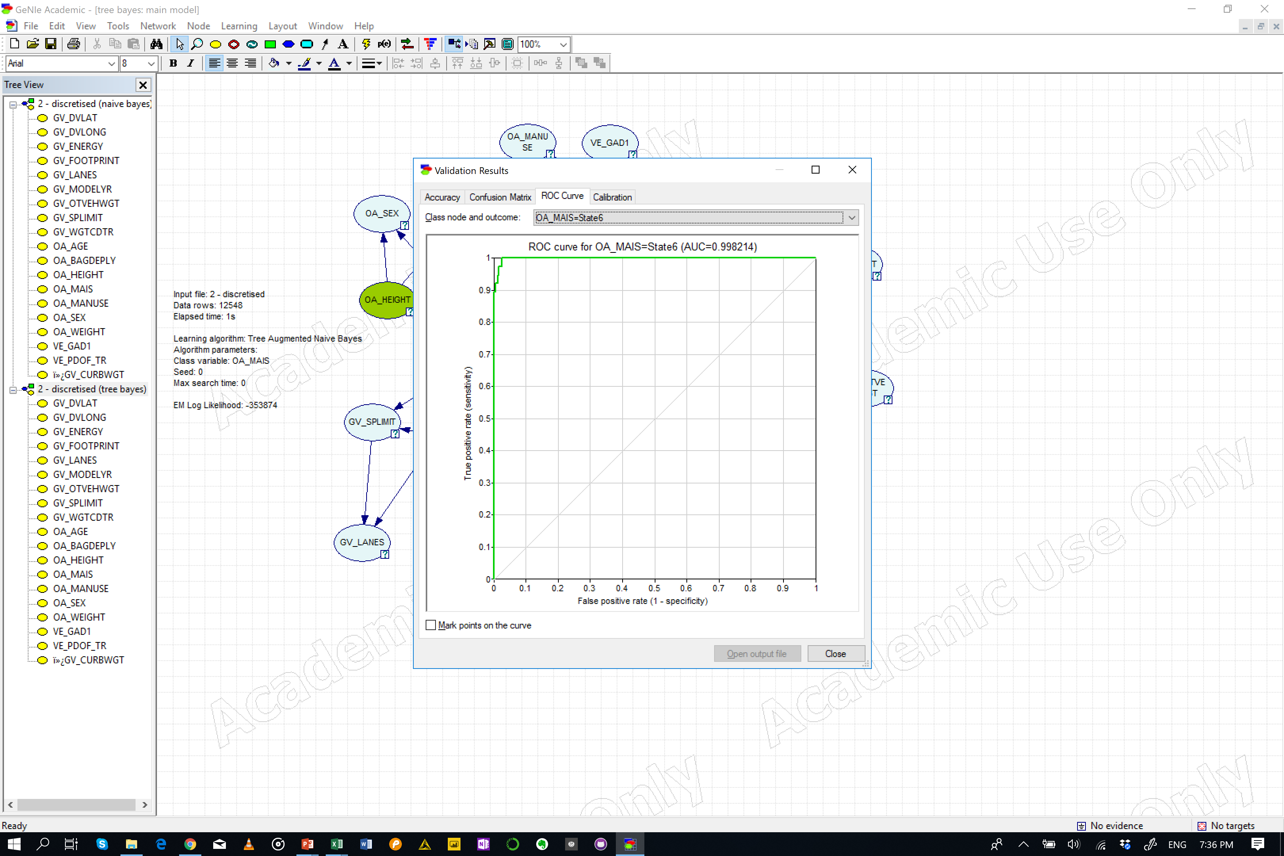
Test
Leave One Out
Tree Augmented Bayes
Accuracy
OA_MAIS = 0.539767 (6773/12548)
State0 = 0.512573 (2181/4255)
State1 = 0.664941 (4110/6181)
State2 = 0.142857 (154/1078)
State3 = 0.269865 (180/667)
State4 = 0.326633 (65/199)
State5 = 0.415385 (54/130)
State6 = 0.763158 (29/38)
 |  | Predicted
 |  | s1_below_0 | s2_0_1 | s3_1_2 | s4_2_3 | s5_3_4 | s6_4_5 | s7_5_up
Actual | s1_below_0 | 2181 | 1896 | 93 | 69 | 10 | 6 | 0
 | s2_0_1 | 1582 | 4110 | 267 | 173 | 32 | 15 | 2
 | s3_1_2 | 165 | 652 | 154 | 82 | 16 | 8 | 1
 | s4_2_3 | 64 | 317 | 83 | 180 | 19 | 4 | 0
 | s5_3_4 | 16 | 57 | 22 | 35 | 65 | 4 | 0
 | s6_4_5 | 5 | 33 | 12 | 21 | 5 | 54 | 0
 | s7_5_up | 0 | 1 | 5 | 2 | 0 | 1 | 29

Slide 11
Test
K-fold (10)
Tree Augmented Bayes
Accuracy
OA_MAIS = 0.535623 (6721/12548)
State0 = 0.501998 (2136/4255)
State1 = 0.664456 (4107/6181)
State2 = 0.143785 (155/1078)
State3 = 0.269865 (180/667)
State4 = 0.321608 (64/199)
State5 = 0.376923 (49/130)
State6 = 0.789474 (30/38)
 |  | Predicted
 |  | s1_below_0 | s2_0_1 | s3_1_2 | s4_2_3 | s5_3_4 | s6_4_5 | s7_5_up
Actual | s1_below_0 | 2136 | 1933 | 95 | 79 | 7 | 5 | 0
 | s2_0_1 | 1588 | 4107 | 264 | 172 | 36 | 12 | 2
 | s3_1_2 | 164 | 653 | 155 | 81 | 15 | 9 | 1
 | s4_2_3 | 60 | 321 | 83 | 180 | 18 | 5 | 0
 | s5_3_4 | 16 | 57 | 24 | 32 | 64 | 5 | 1
 | s6_4_5 | 7 | 37 | 11 | 17 | 9 | 49 | 0
 | s7_5_up | 0 | 1 | 6 | 1 | 0 | 0 | 30

Slide 12
Test
K-fold (20)
Tree Augmented Bayes
Accuracy
OA_MAIS = 0.538173 (6753/12548)
State0 = 0.504348 (2146/4255)
State1 = 0.66753 (4126/6181)
State2 = 0.143785 (155/1078)
State3 = 0.272864 (182/667)
State4 = 0.321608 (64/199)
State5 = 0.392308 (51/130)
State6 = 0.763158 (29/38)
 |  | Predicted
 |  | s1_below_0 | s2_0_1 | s3_1_2 | s4_2_3 | s5_3_4 | s6_4_5 | s7_5_up
Actual | s1_below_0 | 2146 | 1925 | 95 | 76 | 8 | 5 | 0
 | s2_0_1 | 1565 | 4126 | 264 | 176 | 34 | 14 | 2
 | s3_1_2 | 170 | 644 | 155 | 84 | 16 | 8 | 1
 | s4_2_3 | 64 | 316 | 84 | 182 | 17 | 4 | 0
 | s5_3_4 | 16 | 59 | 22 | 33 | 64 | 4 | 1
 | s6_4_5 | 7 | 33 | 13 | 19 | 7 | 51 | 0
 | s7_5_up | 0 | 1 | 6 | 1 | 0 | 1 | 29

